Slide 1
Human in the loop ML

Slide 2
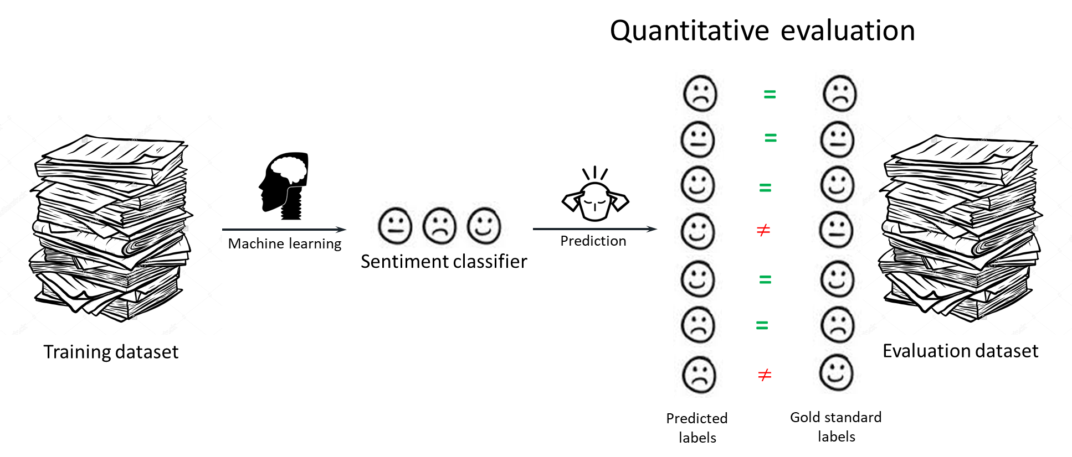
Supervised ML

Slide 3
Human in the loop ML
1. AI Generates Initial Annotations
2. Human Review and Corrections
3. AI Model Learns and Improves

Slide 4
Active Learning

Slide 5
A binary classification task

Slide 7
Active learning
Unlabeled pool of instances

Slide 8
Active learning
Unlabeled pool of instances
Labeled instances + unlabeled pool
Update the ML model
Select instances for labeling

Slide 9
Informative instances?

Slide 10
Expert knowledge involvement

Slide 11
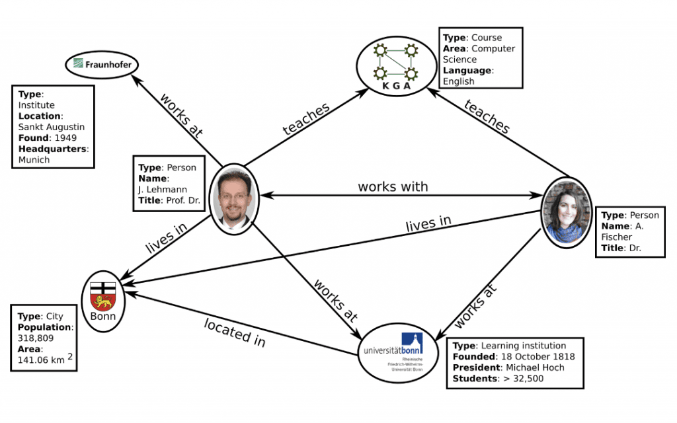
Knowledge Graph

