Slide 1
Reinforcement learning, deep q-networks

Slide 2
Reinforcement Learning
Reinforcement learning is a special learning task type
does not fit into the traditional supervised/unsupervised machine learning categories
It has its own methodology and literature
Instead of a single decision the machine must decide on a series of actions
There is no feedback for the elemental steps, only at the end of the action sequence will there be a reward/penalty
„Rewards” can be introduced into the formal model for each distinct step, but the important part remains the prediction of the correct series of steps, and not of the individual actions
The main goal is to learn a „policy”
The algorithm must try to find the correct sequence of actions
Should the known or the unknown action be taken? (Exploitation/exploration dilemma)
Which step is correct? In which environment or state?
How can the ML model use past knowledge or previous experience?
Practical examples: chess, Atari games, Go, StarCraft …

Slide 3
Types of Reinforcement Learning
Reflex-like Agents (greedy)
Learns a strategy that does not model usefulness, only maps states to actions directly. The simple reflex agent decides based only on the current state and does not rely on the previous states.
Expediency Agents (usefulness)
Learns a reward function based on the states, and decides the actions to take based opun this function. Tries to maximize the value of the expected rewards. The reward is connected to the states or sequence of states for this learner.
Q-learner
Learns a function – Q-function (quality) – which predicts the expected reward based on a state and on an action. The rewards are calculated for the action+state pairs.

Slide 4
Q-learning
One of the simplest reinforcement learning algorithms
Assume that the model has a particular environment described by states, and for each state there are rudimentary steps or actions
For each state and action there is a reward. This can reward the elemental steps, but it might just reward after reaching a positive/desired end state successfully
The Q-learning tries to find a strategy, which maximizes the expected value of the reward based on all actions
Knowledge gathered while training is stored in a so-called Q-table
For learning different sequences of actions must be tried out. This can be random (exploring) or by following the already learnt strategy (exploitation). The ratio of the steps for exploiting/exploring is an important factor for converge (e.g., successful learning, but we will not discuss this in detail here)

Slide 5
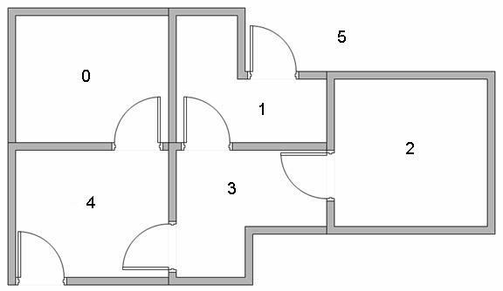
Q-learning Example
Agent
State
Reward
Action
reinforcement learning cycle
Environment
Task: get out from the house as quickly as possible (starting from any of the rooms)
Source: http://mnemstudio.org/path-finding-q-learning-tutorial.htm

Slide 6
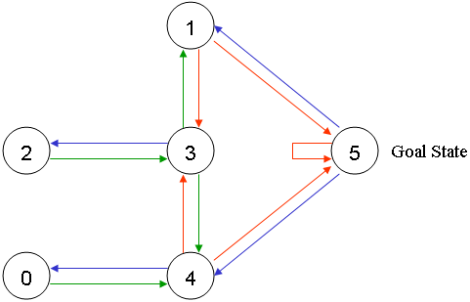
Task Representation
The task can be drawn as a graph, where the nodes (states) are the rooms and the edges (connections) are the actions
Every state-action pair has a reward associated with it
Edges directed at node 5 have a reward of 100 (meaning: success, goal reached)
All other edges get 0 (the usefulness of those actions is not known)
The 5-5 loop edge (or self-loop) (necessary due to technical/implementational reasons) will also have a 100 reward

Slide 7
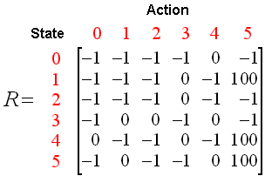
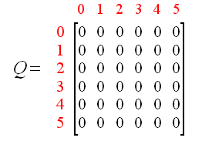
The Q and R-tables
The initial R reward matrix (for all action-state pairs) is:
-1 denotes missing edges (e.g., edges that do not exist)
In addition a Q table is also created, in which the expected reward for a given action in a given state is stored.
Initially all values are 0 in Q (the purpose of training is to find the correct Q values)

Slide 8
The Q-training algorithm
Initialize Q
Choose action from Q
Perform action
Let’s choose a value between 0 and 1 for alpha, and also fill the values for the rewards in the R matrix.
Initialize Q matrix with zeroes.
For each training episode:
Choose a starting state randomly.
Do While goal state not reached
Choose randomly from the possible actions given the current state.
Denote the state which would be visited if the action were to be taken as „next state”
Find the maximum of Q in the next state given the possible actions there
Update the Q value belonging to the actual state and action pair:
Q(state, action) = R(state, action)+Alpha*Max[Q(next state, all actions)]
Transition to „next state”
End Do
End For
Measure reward
Update Q

Slide 9
The Q-training algorithm
Training episode: until the goal state - starting from a random position - is reached; a lot of training episodes are required for successful training.
The essence of the algorithm is the update rule:
Q(state, action) = R(state, action) + Alpha* Max[Q(next state, all actions)]
Effect of the alpha „learning rate”
Values around 0: the immediate reward is more important than long term rewards (these are predicted by Q)
Values around 1: instead of immediate rewards the focus is on the long term expected reward
After training the same algorithm can be used for evaluation, but:
The Q matrix is fixed \ frozen (no updates)
New states are not chosen randomly, but according to the maximal Q values (we are exploiting instead of exploring)

Slide 10
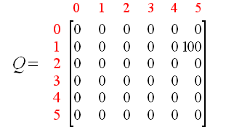
Training episode example - 1
Alpha = 0.8, starting from the 1st room, R is given, Q is empty
Based on R, from the first room we can go to the third and fifth rooms. Suppose that due to random choice we transition to room 5. Then:
Q(1, 5) = R(1, 5) + 0.8 * Max[Q(5, 1), Q(5, 4), Q(5, 5)] = 100 + 0.8 * 0 = 100
The new Q:

Slide 11
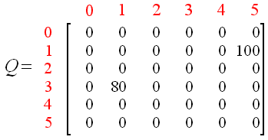
Training episode example - 2
Alpha=0.8, starting from room number 3, we go to the first room randomly and finally to the fifth room.
For the first, then the second step:
Q(3, 1) = R(3, 1) + 0.8 * Max[Q(1, 3), Q(1, 5)] = 0 + 0.8 * Max(0, 100) = 80
Q(1, 5) = R(1, 5) + 0.8 * Max[Q(5,1), Q(5,1), Q(5, 5)] = 100 + 0.8 * 0 = 100
The new Q:

Slide 12
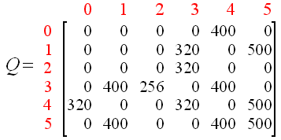
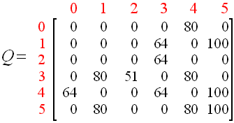
Q-learning examples
After a lot of trial-and-error (training episodes) we get the following:
We can scale this so that the biggest value is 100:

Slide 13
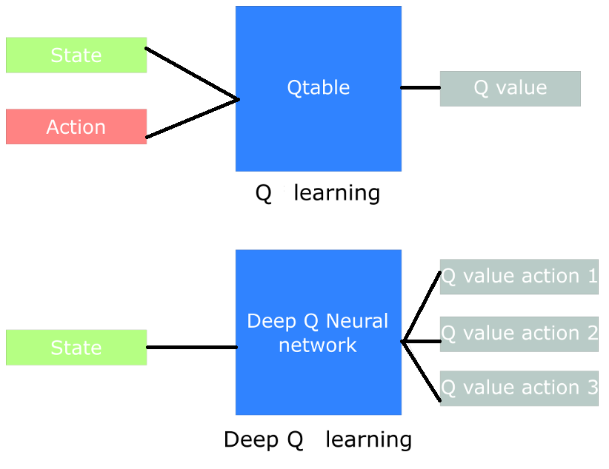
Deep Q-learning
The Q values will be learnt by a neural network instead of using a simple table
The network’s input is the actual state, the output’s neurons correspond to the possible actions, they predict the usefulness of these

Slide 14
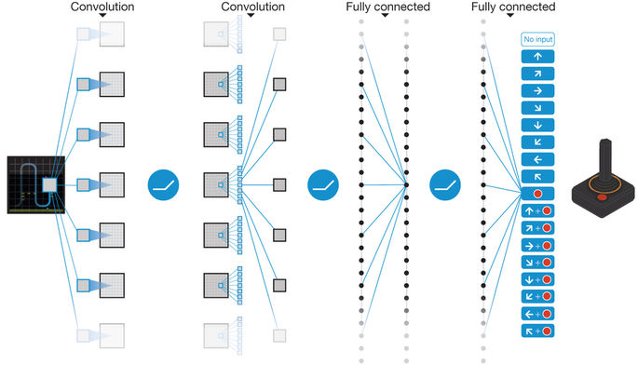
Deep Q-learning
For example this method was used to teach machines to play video games
Input: current image displayed on screen
Output: usefulness of the possible joy-stick movements
Network: a deep convolutional neuronal network
Source: Human-level control through deep reinforcement learning (Nature)

Slide 15
Double Q-learning
An improvement for Deep Q-learning
Motivation: at the beginning of training, nothing is known (the Q-table is completely empty in case of the tabular model)
The Max[Q(next state, all actions)] function provides ambiguous or misleading values, therefore training is slow to start properly
Two neural networks are used instead of just one
One network learns that which states are good choices (instead of the ones giving maximal values)
The second network predicts the Q values belonging to these states
Experience shows that this results in faster convergence and more stable training

Slide 16
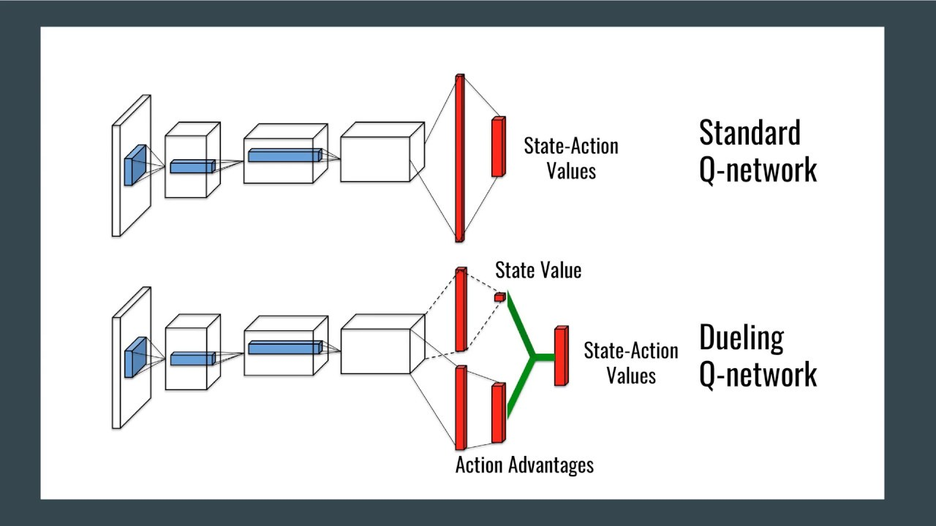
Dueling Q-learning
An other improvement based on deep Q-learning
Also divides the original network to two other ones, but the approach is slightly different
One of the networks predicts how good being in a particular (state – value) pair is, the other gives estimations regarding which action is the best to take (state – action)
Although these two things are approximated independently, later in a higher level they are combined
Why are these separate predictions effective?
Some states are by default „good”, no matter what action is chosen (e.g., no enemies are nearby), or others are „bad” (no matter what we do, we will lose
Handling of such scenarios is easier with dueling networks

Slide 17
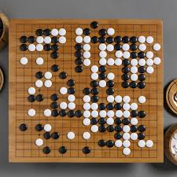
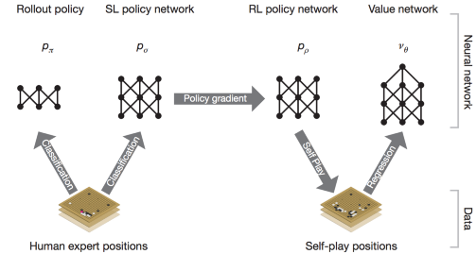
Alpha Go
Developed by Google
Defeated the go world champion in 2015
Contains two deep networks:
policy network: estimates what action is worth taking
value network: estimates the expected reward for that action
(like the action and value networks from the prev. slide)
Initially the two networks were trained in a Supervised Learning (SL) scenario, 30 million human moves were used (left side of the figure)
Then further training was in self-play mode with reinforcement learning (RL) for the policy and value networks

Slide 18
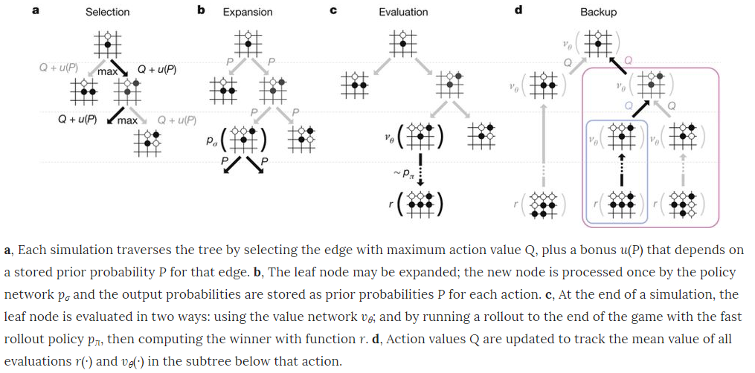
Alpha Go
To find long term strategies the neural networks are combined with a heuristic search algorithm
This is the Monte Carlo Tree Search (MCTS):

Slide 19
AlphaGo Zero
Similar to the „basic” Alpha Go, but does not require „pre-training” based on human games to learn
Learns by playing against itself
Modifications compared to Alpha Go:
The representation of the table was simplified
The policy and value networks were merged (dueling)
Instead of convolutional, a hybrid convolution+residual network
Simpler tree-search with the help of the unified network (no „rollout”)
Alpha Go could discover novel, meaningful strategies and moves that were previously unknown to human expert players

Slide 20
Q-learning example code
Source (TF 2 for Reinforcement Learning): https://alexandervandekleut.github.io/q-learning-tensorflow/
Source2 (Implementing a Q-Net to Frozen-Lake at Colab): https://wikidocs.net/174549

Slide 21
THANK YOU FOR YOUR ATTENTION!
A tananyag az EFOP-3.5.1-16-2017-00004
pályázat támogatásával készült.

