Slide 1
Other Training methods

Slide 2
Backpropagation and its alternatives
By far the most popular and widely spread training algorithm
Simple working principle, easy implementation
Only the derivative is needed
Can be used in batch mode, this way loading and\or manipulating the whole training dataset is not required
The base backpropagation algorithm has some more refined variants
Basically the calculation of the derivative and the learning rate is finetuned
Older methods: Momentum, Quickprop, resilient backprop, …
More recently: Adagrad, Adadelta, Adam, …
Improved optimalization techniques – what are the expectations?
Global optimum – this will not be possible…
Better local optimum
Faster convergence
Fewer meta-parameters (hyperparameters, e.g., LR) that require manual tuning

Slide 3
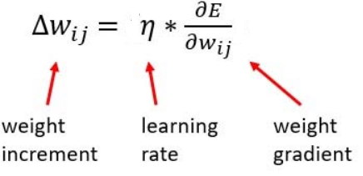
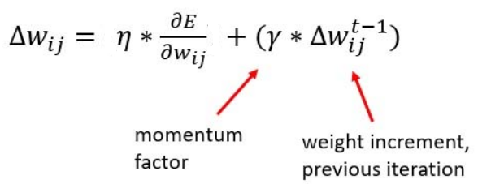
The Momentum Method
Remember, how do we change the weights:
Now we expand this with a „momentum” term:
Where the „momentum factor” is a value between 0 and 1
Effect: the Δ value is smoothed over time, gives it „impulse”
Can help overcome smaller local optima

Slide 4
Adagrad
Separate learning rates for each and every parameter
The learning rate is divided by the squared sum of the derivaties so far
Parameters causing higher derivatives get smaller a learning rate
For small derivatives a higher learning rate is assigned
Advantages:
Balances the Δ values of the parameters
No need to change the learning rate while training, it controls itself
Disadvantages:
Because all of the previous derivatives are summed the learning rate will decrease quickly
In experience, it converges slower and gives a little bit worse performance than a properly configured backprop with momentum

Slide 5
Adadelta, Adam, …
Adadelta: during summation it only takes into account the last k deltas, or all of them but with an exponentially decreasing weight
The rapidly decreasing learning rate of Adagrad is countered
Adam:
Also calculated a running average but takes the standard deviation into account too
There are even newer, improved variants:
AdaMax, Nadam, Eve, …

Slide 6
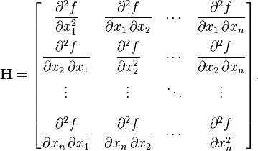
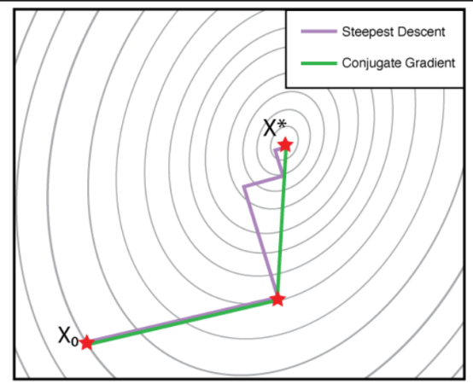
More Sophisticated Optimalization Methods
Newton-method and its relatives
The second-order derivative is required → the Hesse-matrix in multivariable cases
n variables mean this is nxn
This is too big for neural networks
And it needs to be inverted in every iteration step…
Quasi-Newton-methods – only approximating the Hesse-matrix
E.g., L-BFGS
Conjugate gradient methods – also trying to avoid the computation and inverse of the Hesse-matrix
Line search in a given direction + always steps perpendicularly regarding the previous directions
Finds the optimum of an n-dimensional quadratic surface’s optimum in n steps
Non-quadratic surface – the above-mentioned steps are repeated

Slide 7
More Sophisticated Optimalization Methods
In comparison studies backpropagation performs the same or just a little bit worse
It could be beneficial to combine the two method families, e.g., at the early stages of training the error could be minimized quickly with backpropagation, then near the end the conjugate gradient or the Quasi-Newton methods could be introduced
General consensus presently:
The extra burden of the complex mathematics and harder implementation is not worth it for the small amount of improvement/speed which are observed at some tasks

Slide 8
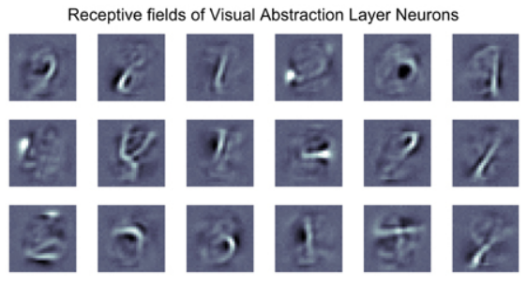
Current use of DBNs
Training DBNs with CD-criteria is an unsupervised training scenario
DBN-pretraining still makes sense, if there are a lot of unlabelled and a very few labelled entities
The connection between the two layers of the RBM is symmetrical
Thus the input can be re-generated from the hidden layer
The representation formed by the hidden layer is easy to visualize

Slide 9
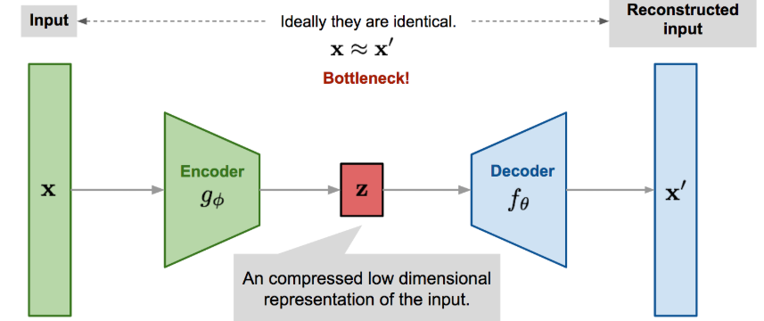
Unsupervised Training of Deep Neural Networks
The standard deep networks can also be trained in an unsupervised fashion (meaning: without the labels containing the corresponding classes)
The most commonly used structure capable of this is the so-called autoencoder network structure, when the training labels are the same as the input
The network is trying to reconstruct its input on the output
The autoencoder network is usually similar to a sand-glass in shape (compression is enforced by the ever smaller layers)
The middle-most, smallest layer is called the ‚bottleneck’ layer

Slide 10
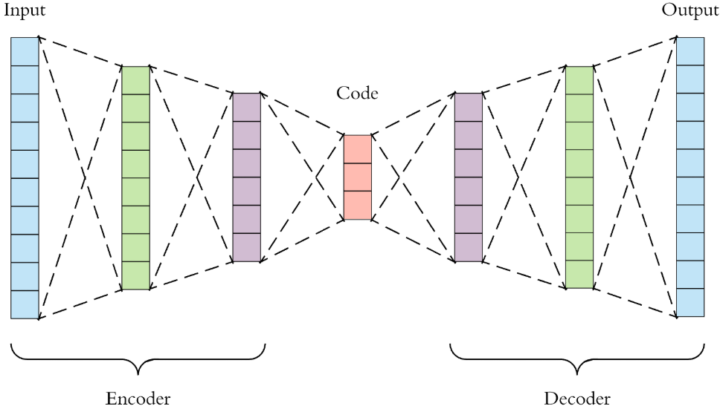
Autoencoder Networks
What are autoencoders good for?
During training the network is forced to find a compact/compressed representation, from which the input should be reconstructed as accurately as possible
It can be used to feature-space reduction (the decoder part is disregarded, and instead of the original input features, the bottleneck layer’s output is used)
But it is also able to be train unsupervised (if there are a lot of unannotated data examples and only a few are labelled, then the autoencoder can be trained, then the decoder part is dropped and using the remaining output layers supervised training is commenced)

Slide 11
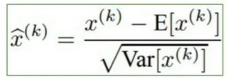
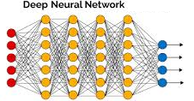
Batch normalization
We claim that normalizing the input features to have a mean of 0 and a standard deviation of 1 helps in training (This is basically a scaling and an offsetting)
In deep networks, the k-th layer’s input if the k-1-th layer’s output
But then the k-th layer would also learn easier if the previous layer’s output would have a mean of 0 and a standard deviation of 1 – for this the amount of scale and offset need to be calculated
We could train only the first layer then calculate the output’s mean and std, normalize, then add a new layer to the network, and so on…
But this is hard and sluggish (slow)

Slide 12
Batch normalization 2
A more effective solution is: normalizing in an „online” manner, for the current batch only
Meanwhile the proper scale and offset parameters are learned
They are regarded as learnable parameters in the same way as the weights of the network
The backpropagation algorithm can be extended to include these and learn them while training
During testing, the learned values of mean scale and standard deviation offset are used
Positive effects of batch normalization:
Faster convergence
A larger initial learning rate value can be used
Training of deep networks results in better performance
The network will be a little bit less sensitive to initial weight values

Slide 13
Very Deep Neural Networks
The definition of a „deep network” is not exact, it usually means 5-10 hidden layers
Recently, very deep networks were introduced, typically for image processing and computer vision tasks
This is also not defined, but there are networks with 50-150 hidden layers
For very deep networks, the tricks and practices explained before are ineffective for backpropagation
ReLU neurons, clever initialization, batch normalization,…
To train deeper layers new tricks are needed

Slide 14
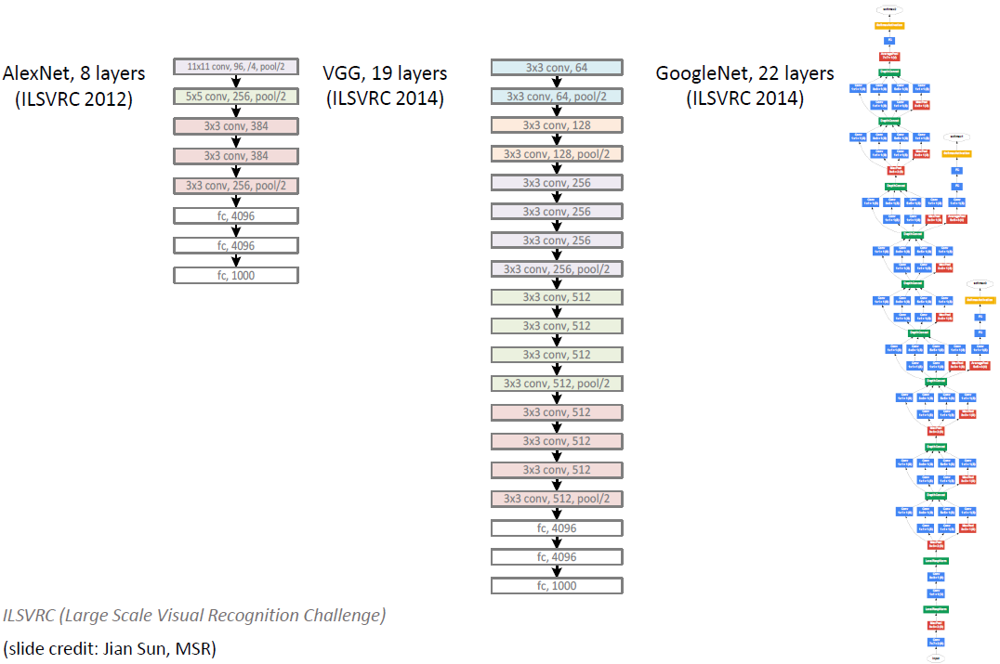
Very Deep Neural Networks - examples

Slide 15
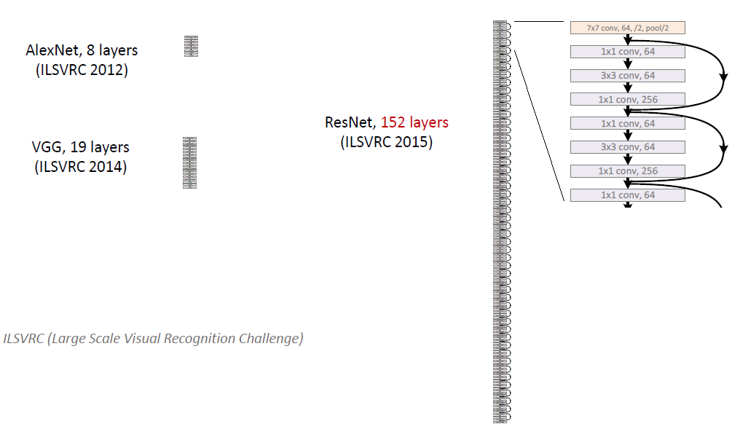
Very Deep Neural Networks - examples

Slide 16
Very Deep Neural Networks with extra connections
The error goes through a lot of layers when backpropagating to deep layers (id. layers farther away)
The error changes in every layer – the risk increases that it will vanish or „explode”
The commonality of the proposed methods is that the networks are extended with extra connections, so that the error can affect the deeper layers while only suffering a reduced number of transformations
Common names for these connections, networks:
„linear pass-through” or „jump” or „skip” connection
Names of such network architectures:
„Highway network”
„Residual network”
„Linearly augmented network”

Slide 17
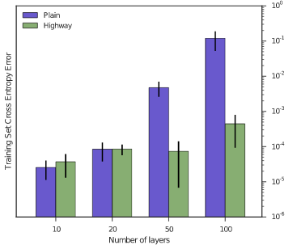
Highway Network
The new connections form an ”information highway”, where the information can flow through without any transformations
Base idea: in recurrent networks the error needed to be propagated back through many layers, the LSTM’s gating mechanism solved it
Traditional layer’s output:
Highway network’s layer:
where T is the „transfer gate”:
T is a value between 0 and 1
Output when T=0 T=1:
So T regulates the ratio of untransformed x and transformed H(x)
Example: speech recognition error

Slide 18
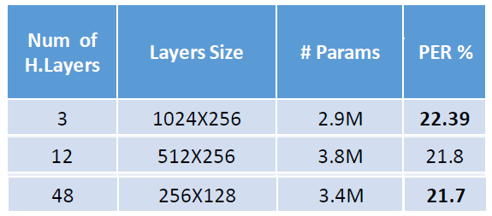
Linearly Augmented Network
Simpler solution compared to the gate mechanism
The output of a traditional network’s layer
(compared to our earlier notation V is an extra linear transform):
The linearly expanded layer will however calculate the following:
So the output contains the sum of a traditional non-linear and a linear transformation
T is not necessarily a complete trans- formation matrix. Good results were observed with a diagonal matrix, moreover with fixed (not-trainable) identity matrix
Example: speech recognition results
(Results on TIMIT, taken from Droppo et al, ICASSP 2016)

Slide 19
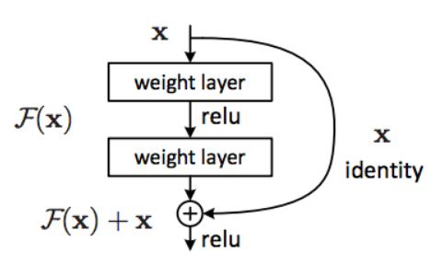
Residual network
This approach’s essence is that gating might be overly complex
Furthermore, not even a linear transformation is needed
Through the extra connection the information reaches the output without any transformation („identity mapping”)
If the earlier layers have already solved the task, identity projection is enough, F(x) has no need to learn
What the previous layers have not learned, that „residual” error needs to be driven back and be learned with the help of the non-linear F(x) mapping

Slide 20
Thank you!
A tananyag az EFOP-3.5.1-16-2017-00004
pályázat támogatásával készült.

