Slide 1
Regularization
A tananyag az EFOP-3.5.1-16-2017-00004
pályázat támogatásával készült.

Slide 2
What is overfitting?
Example: an extra-terrestrial (UFO) lands on Earth in order to investigate humans
He watches 10 people then concludes the following: humans have two legs, two arms, one head and their eyes are brown
While the first three observations are true, the fourth is only true for that 10 people → overfitting
Overfitting: the model learns not only the general features but also the strange or weird patterns of the finite dataset
Naturally the chance of such an occurrence can be lowered by the introduction of more and new examples, but when considering an infinite space, a finite number of examples will never be completely representative of the whole
By increasing the flexibility of the machine learning model, the chance of overfitting also increases (the model can pay more attention to small details)
To decrease overfitting, it is absolutely necessary to use an independent data set for testing and evaluating

Slide 3
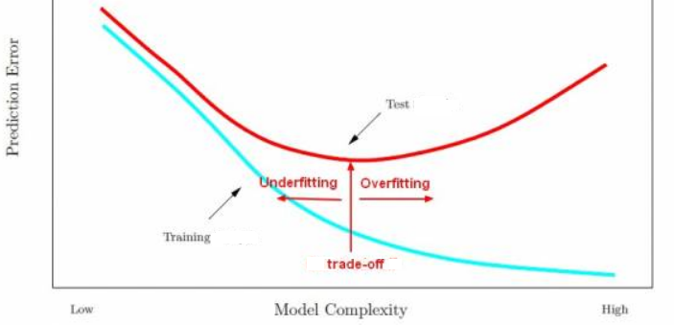
Properties of Overfitting
By increasing the model’s size (complexity), the flexibility also increases, so it will become more accurate on training examples
However on the test examples, the performance will decrease after a while
This is why we can find the optimal model-complexity using an independent test (or validation) set

Slide 4
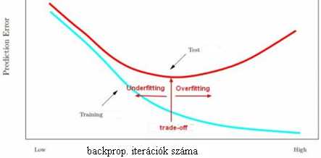
Overfitting of Neural Networks
The flexibility of neural networks is usually boosted by increasing the number of neurons and the number of hidden layers
Besides overfitting generally occurs near the end of training by backpropagation
Basic tools to combat overfitting:
Stopping training sooner
Trying to keep parameter count low

Slide 5
„Early stopping”
Easiest to implement with the help of a validation set
We have touched upon this when we wanted to set a good learning rate
Let us refresh (our knowledge) a bit
Updating the learning rate by using a validation set
Separate a part of the training set before fitting → validation set
Save the current weights before every update step
(e.g., after 1 epoch) evaluate the loss on the validation set
If the loss’s decrease is smaller than a threshold compared to the last iteration’s → halve the learning rate, new iteration
If the loss would have increased, the previous weights would have been restored
Complete stop: if the value of the learning rate reaches a threshold or the validation set’s error has been increasing for several steps

Slide 6
Regularization
Trying to use fewer learnable parameters lowers the probability of overfitting
But it can also hurt model performance
The maximum cannot be reached by a model with an arbitrary parameter count, because the optimalization algorithms do not guarantee global optimum
So in practice it is a better strategy to overparameterize a model, but also extend the loss function with an extra term, e.g:
This is regularization - the λ weight controls the strength of regularization
The task of the loss function’s regularization term is to prefer the „simpler” models over the „overfitted” ones during optimization when there are two models with identical loss values but different shape descriptors
This can be interpreted differently for various machine learning algorithms, let’s look at the case of the neural networks now

Slide 7
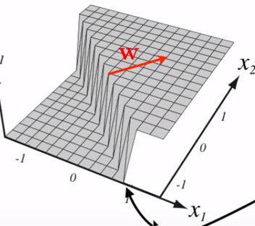
Regularization of Neural Networks
A lot of hyperplanes make up the decision surface of neural networks, its smoothness cannot be directly influenced
Let’s see what we can do for one single neuron:
The activations are on one hyperplane:
The decision surface is a hyperplane where:
The sigmoid function „bends” the two ends of the hyperplane to 0 and 1
If we multiply the weights with a large constant, then the decision surface will stay at the same place, but the hyperplane will be steeper, so the sigmoid will converge more steeply to 0 and 1
That means that neural networks with bigger weights make more „confident” decisions, which we would like to avoid at the beginning of training (overfitting)
We have discussed that this is bad also for the training, (because the derivative will be small), if the weight values are large
This is why the weights are initialized with small values and the features are normalized to have a standard deviation of 1

Slide 8
Weight decay
The simplest regularization method is to force the network to prefer smaller weights – this is weight decay
With formula (for mean squared error, but the base loss can be different):
Why is it called weight decay?
Remember, according to the backprop rule
With the regularization loss from above
So the weights get multiplied by a constant a little bit smaller than 1
Because of this the weights – at least those that are not kept large be mean squared error in any case – converge towards zero
It is also called L2 regularization (the 2nd norm of the weight vector is regularization term)

Slide 9
Sparse Neural Networks
Instead of the 2nd norm, the 1st norm can be used also – this is the L1 or „Lasso” regularization
In this approach, we are not multiplying the weights with a constant smaller and close to 1, but add or subtract a small constant (depending on the sign)
This regularizes more aggressively, it does not only force weights towards zero, but it can make them equal to zero
Apart from the weights, it can be used with the output of neurons, so the less useful neurons are pressured towards 0 (for example the ReLU neurons, which can output zero otherwise too)
The network can be nudged towards a sparse structure (where edges or even neurons can completely disappear) instead of a „fully connected” This way we approach the original goal against overfitting: fewer parameters but in a „soft” form

Slide 10
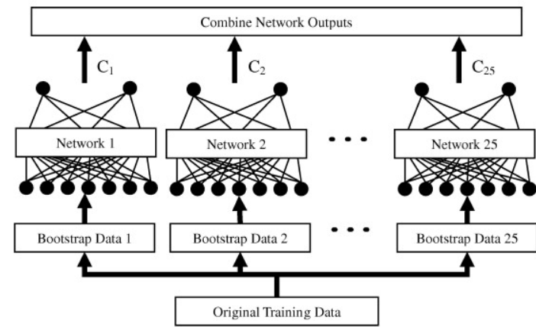
Ensemble Neural Networks
The network can be trained several times if the training dataset is not too big
Due to random initialization and data shuffling, we will get slightly different weights each time
But we can even train on a random or strategically/methodically selected subset of data
Finally the output of the resulting models is averaged, so we get an „ensemble” model
Averaging this way stabilizes the model, because the strange properties or noise in the subsets will not affect the model decisions that much

Slide 11
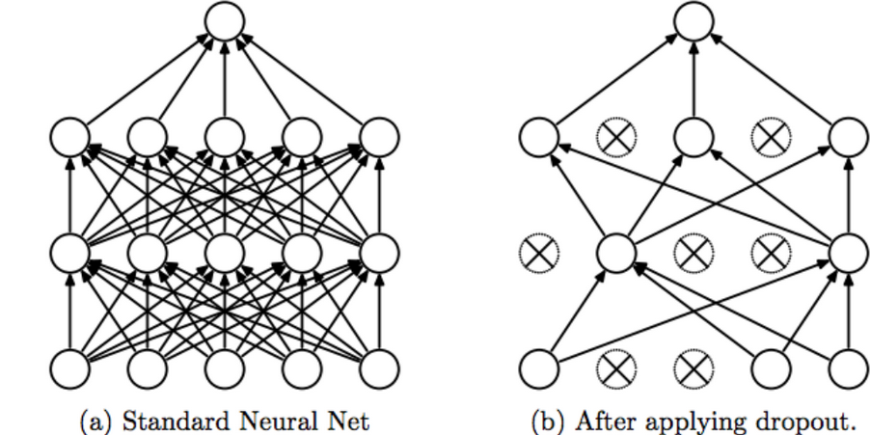
Dropout
During training, some neurons are „dropped” according to a random probability (e.g., 0.2), make them zero (for the current input vector, in the next example, they will function normally!)
This forces neurons to learn independently, do not rely too much on the neighbours
Why does this regularize?
It can be shown, that it has an effect similar to training the network’s all possible parts (sub-networks), in other words, train 2^{N} networks in parallel and compute their average
Technical problems
Makes training slower, more iterations (5-10x) are required over the data
A given neuron will have less input sources → the remaining inputs are multiplied by a constant so the sum is in a similar scale

Slide 12
Noise Injection
Tiny (usually normally distributed) noise is added to the input, or to the output of certain neurons
Practically speaking, this is a special „stupid” case of data augmentation (when we do not know what transformations would be beneficial)
Experience shows that this also helps against overfitting, especially when there is very little train data
There are several variants, where the noise is added to the objective function, or even to the labels
https://machinelearningmastery.com/train-neural-networks-with-noise-to-reduce-overfitting/

Slide 13
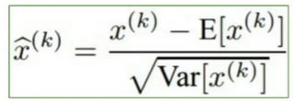
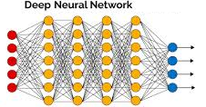
Batch normalization
We claim that normalizing the input features to have a mean of 0 and a standard deviation of 1 helps in training (This is basically a scaling and an offsetting)
In deep networks, the k-th layer’s input if the k-1-th layer’s output
But then the k-th layer would also learn easier if the previous layer’s output would have a mean of 0 and a standard deviation of 1 – for this the amount of scale and offset need to be calculated
We could train only the first layer then calculate the output’s mean and std, normalize, then add a new layer to the network, and so on…
But this is hard and sluggish (slow)

Slide 14
Batch normalization 2
A more effective solution is: normalizing in an „online” manner, for the current batch only
Meanwhile the proper scale and offset parameters are learned
They are regarded as learnable parameters in the same way as the weights of the network
The backpropagation algorithm can be extended to include these and learn them while training
During testing, the learned values of mean scale and standard deviation offset are used
Positive effects of batch normalization:
Faster convergence
A larger initial learning rate value can be used
Training of deep networks results in better performance
The network will be a little bit less sensitive to initial weight values

Slide 15
Multi-task training
Neural networks are usually given multiple (generally 2) learnable problems in parallel – this required a special network structure
Originally it was developed to solve two tasks at once, but:
It was observed, that oftentimes the results were better than two separately trained networks'’
Reason: training „together” has a regulatory effect
Example from speech recognition (see next figure): main task is to recognise the spoken speech sounds, the secondary task is to identify the speaking person

Slide 16
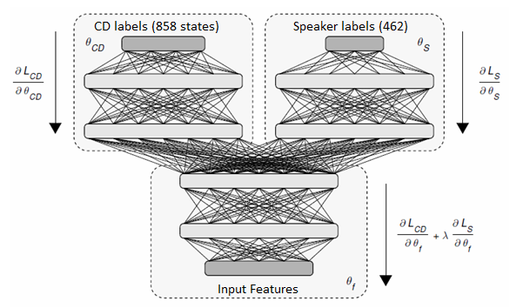
Multi-task Network Structure
To solve two tasks in parallel a special network structure is needed:
Common input layer and lower hidden layers
Task-specific layers above
Two output layers
Two cost functions are minimized
During backpropagation the weighted errors from the two branches are summed (λ parameter)

Slide 17
Multi-task Training
Obviously this makes sense if the two tasks are similar but not the same
Apart from λ an additional parameter is also used to determine the ways of the branching depth of the network
Seems sensible, that for increasingly dissimilar tasks, the point of network separation should happen sooner (less common and more task-specific layers are needed)
But this can only be determined by experimentation
What are the advantages of multi-task learning (apart from the fact, that 2 tasks are solved at the same time)?
The network needs to find a representation in the common layers, that helps to solve both tasks
This has a regularization effect (less overfitting, better generalization)
Often the performance is better than if the two tasks were solved separately

Slide 18
Adversarial Multi-task Training
Introduces a spin into the multi-task model
Instead of minimizing the error of the secondary task, it is being maximized
Technikal implementation: λ is chosen negative, the error of the second branch is still being minimalized
The task-specific layers are trying to minimize
The changed sign only has an effect in the uppermost common layer
We only need to change a single sign in the code
The absolute value of λ should be increased incrementally in c steps
So in iteration k:
Effect: the network tries to find a common representation, that is very bad for solving the second task
In the previous example, it would look for a speaker-independent representation

Slide 19
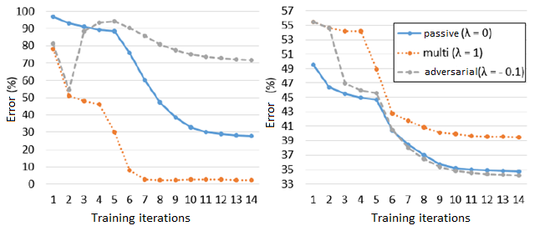
Visualizing Training with our Example
Left side: The secondary (speaker identification) branch on the training set
Right side: primary task error on the development set
„passive” learning: the secondary branch trains, but has no say about the forming representation in the common layers (the main branch trains „single-task”)
Result: the multi-task makes it worse, the adversarial multi-task helps a little on the accuracy performance of the primary (speech recognition) task

Slide 20
Thank you!
A tananyag az EFOP-3.5.1-16-2017-00004
pályázat támogatásával készült.

