Slide 1
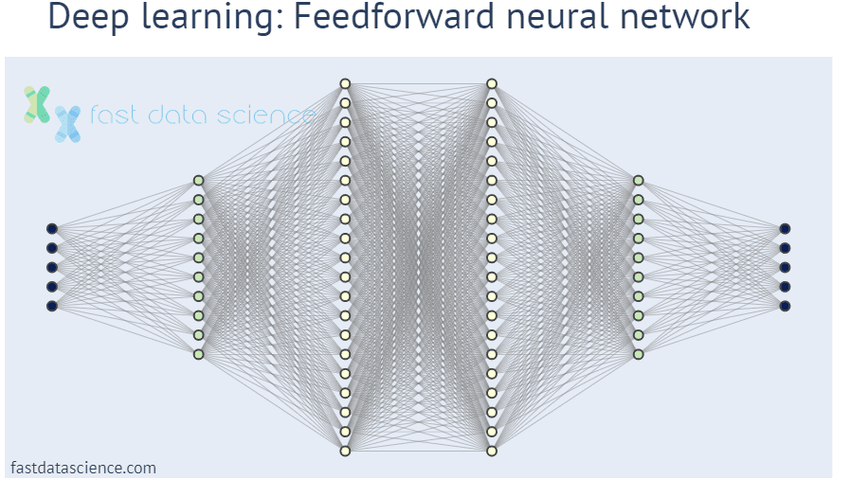
Deep Neural Networks

Slide 2
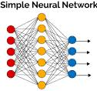
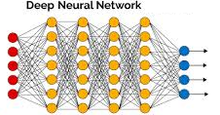
Traditional and Deep Neural Networks
What is the difference between a traditional (shallow) and a deep neural network?
Structurally, there are a lot more hidden layers (Instead of 1-2, there are 5-10, or even 100-150)
Sounds straightforward – why just now??
To train deep networks, new algorithms were needed
First: DBN-pretraining, 2006
The real advantage of deep networks can only be observed when huge amounts of data is available
This criteria was also not fulfilled in the 80’s
Training a deep networks is very expensive computationally
GPUs can solve this issue
The success of deep networks nowadays depends upon new algorithms, a lot of training data and more compute capacity

Slide 3
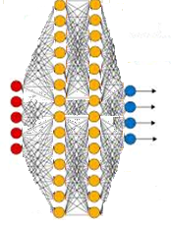
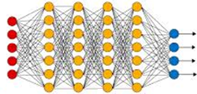
Why are deep neural networks more effective?
Previously we introduced a theoretical proof that every machine learning task can be solved with two hidden layers
But this is only true if: the neural network size is endless, the data set is infinite and the optimalization algorithm guarantees a global optimum
Given the constraints regarding the (finite) number of neurons, it is more efficient to use several narrow layers instead of 1-2 wide ones
Then the network is able to process the data hierarchically
When solving shape recognition tasks of images, it can be observed that the higher (deeper) layers are using more complex, more abstract features
Point, edge, → eyes, nose→ face→…

Slide 4
Learning Deep Networks
The training of deep networks is unfortunately harder than the training of shallow ones
The main reason for this is the working principle of the backpropagation algorithm, and the shape of the sigmoid activation func.
The backpropagation algorithm propagates the error backwards from the output layer
The more layers we go backwards, the higher the chance that the gradient will „vanish”
This is the so called „vanishing gradient” effect
In practice this hinders the ability of the deeper layers to learn
In other words, there is no use adding more layers to the network, the performance will not increase (performance might even get worse)

Slide 5
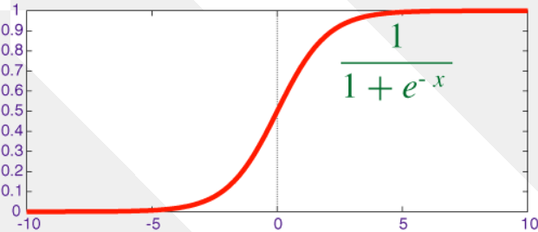
Why is the training of deep networks cumbersome?
Let’s look at the effect of the sigmoid activation function:
The input of the sigmoid func. is the activation:
When the activation’s value is very big or very small, it will use the „plain” parts of the sigmoid
In these places, the derivative is close to zero, it „vanishes”, so the training will get stuck
We are trying to avoid this by the random initialization of the weights or by the normalization of the input
Although these approaches are not enough to handle the values of deep layers
With the additional number of hidden layers, the difficulty of training also increases

Slide 6
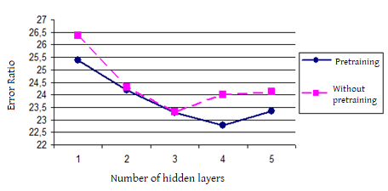
Deep Network Training - example
The figure shows the results from a speech recognition task
Vertical axis: recognition error
Horizontal axis: number of hidden layers in the network
The purple curve shows the results when training with backpropagation
The increase in performance gets smaller and smaller as more layers are added, it even decreases around 4-5 layers
The blue curve shows the results belonging to one of the earliest proposed methods (pretraining) for learning deep networks

Slide 7
Solutions for Training Deep Neural Networks
To train deep networks, the training algorithm and/or the activation function need(s) to be changed
Most popular modification strategies:
Pre-training with unlabelled data (DBN-pretraining with contrastive divergence (CD) loss function)
This was the first idea, relatively slow and mathematically complex
Building and training the network layer-by-layer
Much simpler and only backpropagation is required
Usage of new activation functions
The simplest solution, we are going to examine this first
There are further tricks that help learn deep networks (batch normalization, highway network, etc. ) – more about these later…

Slide 8
DBN-pretraining
Historically this was the first deep neural network training algorithm (2006)
It consists of a pre-training and a fine-tuning step, where the fine-tuning is done through the already familiar backpropagation method
Pretraining step:
Constructing a so called „deep belief” network
This is trained using a completely different algorithm from backprop.
Training step:
The pretrained DBN network is converted into a traditional network (employing the sigmoid activation)
This is trained using the backpropagation algorithm
This step is called „fine-tuning”

Slide 9
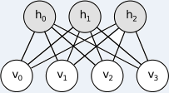
Restricted Boltzmann-machines
To introduce deep belief networks, we need to familiarize ourselves with Restricted Boltzmann Machines (RBM)
Similar to a layer-pair of a neural network
But instead of real values, its output is binary
V: „visible” layer: this is the input and the output layer (in one/at once)
H: „hidden” layer
The connections of the visible and hidden layers are not deterministic, but stochastic
Apart from this, the equation is quite similar to the standard neuron’s (with sigmoid activation function)
Mark that unlike standard neurons, the V and H layers play a simmetric role, data can travel in both directions

Slide 10
Training RBMs
The Contrastive Divergence (CD) algorithm is used to train RBMs
Unsupervised learning method (no labels)
Iterative algorithm, just like backpropagation
The goal is to reconstruct the input based on the hidden layer (Similar to the Maximum Likelihood objective function)
Starting from the original input, the algorithm alternates updating the hidden and the visible layers
We are aiming to make the reconstruction as similar to the original input as possible
Finding the ideal representation would require an infinite number of iterations
In practice we are trying to approximate it using only one iteration then moving on to the next data vector
Iterating over the statements described above we get the CD algorithm

Slide 11
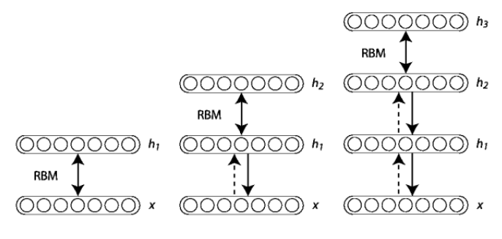
Deep Belief Network (DBN)
DBMs are formed by stacking RBMs on top of each other
We are not training the full networks, but building it up layer by layer
1 hidden layer → training
Adding a new hidden layer → training
…

Slide 12
Conversion to Deep Neural Network
After DBN pretraining the neurons of the RBM are converted into regular neurons (by preserving the weights of course)
At the top a softmax layer is appended with as many neurons as there are class labels
And from this point on, training can start with supervised backpropagation using the labelled entities
The purpose of the pretraining is the initialization of the weights
Results are better than the random initialization’s (see previous example)

Slide 13
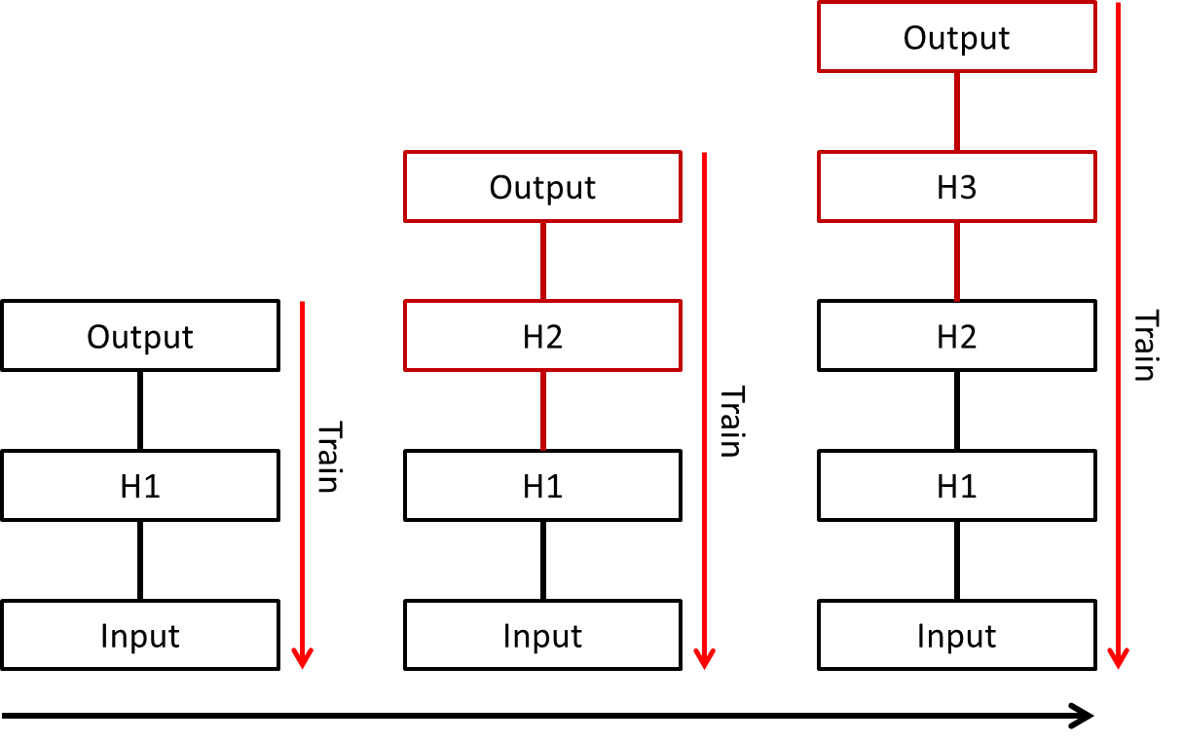
Discriminative Pretraining
This method also tries to make training deep networks more feasible
The base idea is borrowed from the DBN-training: the network is not learned all at once, instead layers are constantly added on top
But: train in a supervised („discriminative”) way, with backpropagation

Slide 14
Discriminative Pretraining (2)
Advantage of the method: easy to implement, no need for a new training algorithm, plain backpropagation is used only
Disadvantage: longer training times
However according to empirical experiences, there is no need to train each layer until full convergence, a few iterations are enough („pretraining”)
Complete training is only conducted after the last hidden layer’s addition was finished
Experience shows that due to „pre-training” the weights obtain better initial values compared to random initialization
Stemming from this good initialization form, the last „full” training step are less likely to get stuck in a local optimum

Slide 15
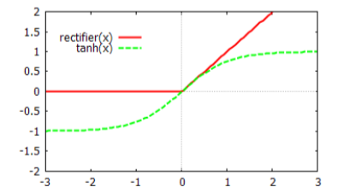
The Rectifier Activation Function
This method does not interfere with the training approach, instead a new activation function is employed
The figure below shows the rectifier activation function
Equation:
Compared to the tanh activation function:
Its response is linear to positive inputs, zero to negative inputs
Note: The activation function must be non-linear!
For positive inputs the derivative is always1, it does not vanish no matter the place (location) on the function’s curve
When the input is negative, the output and the derivative too equal to zero

Slide 16
The Rectifier Activation Function
Advantage: the derivative is never zero to positive inputs
Disadvantages:
However for negative inputs, it is always 0
It seems that in practice it is usually not a big issue
Not symmetrical (only outputs non-negative values)
This doesn’t seem to be an issue either
The output is not bounded, so it can produce an infinitely large output value too
There are tricks to handle this, e.g., the normalization of the size of the weights from time to time

Slide 17
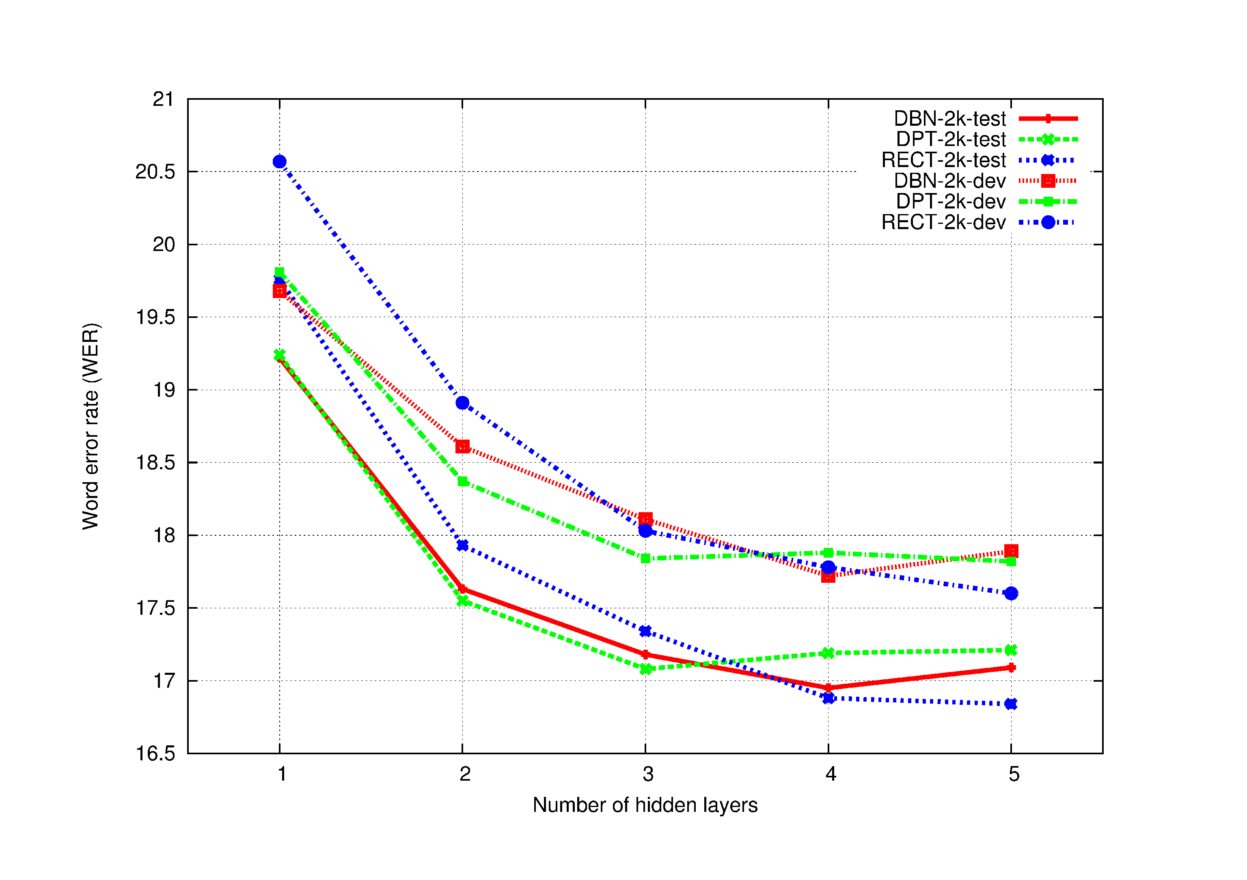
Comparing the Three Methods
Experimental comparison on speech recognition data using the test and dev sets
DBN: DBN-pretraining, DPT: discriminative pretraining, RECT: rectifier network

Slide 18
Comparing Training Times
Run times for the three training methods on the previous task (with five hidden layers):
While the performance results regarding the three methods were pretty similar, the training time requirements for the Rectifier Network are a lot smaller, because pretraining is not needed
Presently the de facto standard in deep learning is the „rectified linear” (ReLU) activation function

Slide 19
More recent, novel activation functions
There are proposals for even newer activation functions
They are supposed to combat the issues mentioned previously
See more: https://en.wikipedia.org/wiki/Activation_function
Examples: ELU, SELU, Softplus, Swish, Mish…
Sometimes better results are observed while using these instead of the rectifier function, but neither of them caused a major breakthrough

Slide 20
Thank You for Your Attention!
A tananyag az EFOP-3.5.1-16-2017-00004
pályázat támogatásával készült.

