Slide 1
Neural networks and Neural Network training with the backpropagation algorithm

Slide 2
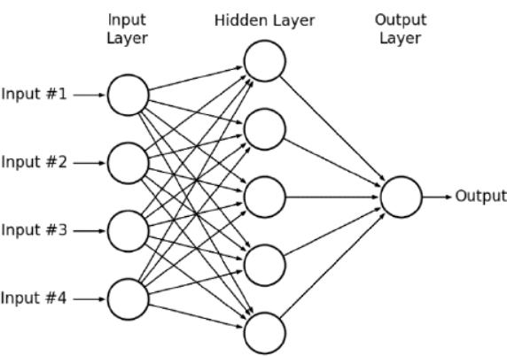
Neural Network instead of Neuron
Increasing the representational power of a Neuron: Let us build a network!
Classical structure: Multilayer feedforward network
Every layer receives input from the layer below
Between two layers, every neuron is connected „full connection” = fully connected, dense
Only feed-forward connections
It is rarely used, but:
„sparse” network instead of fully connected
Skipping layers can also be relatively easily implemented
Recurrent structures are also possible, however they are harder to train (later: recurrent neural networks)
Useful for modelling time series data

Slide 3
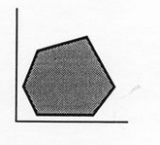
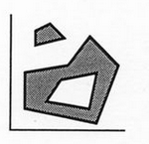
Representation power of the neural network
Enclosing a convex volume (space): 1 hidden layer is sufficient
Neurons of the hidden layer represent 1-1 boundary line
The output neuron operates as an AND gate: it signals, where all of the hidden neurons signal
Learning an arbitrary (even non-convex, not connected) space: 2 hidden layers are enough
First hidden layer neurons represent lines
Second hidden layer neurons describe parts of the space using the AND operation
The output neuron can connect these non-convex, loose parts into connected areas (volumes) using the OR operation
In theory every learning problem could be solved by two hidden layers
For arbitrary accuracy, infinite neurons, training data and a perfect optimalization method (guaranteeing global optimum) would be required…

Slide 4
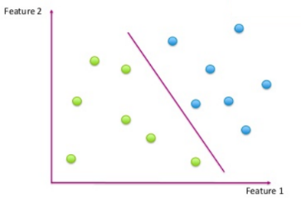
Multiclass learning
A single neuron can only separate 2 classes
A neural network can solve problems with multiple classes
Solving multiclass problems with neural networks
An output neuron is assigned to every c_{i} class
The network is expected to output a value of one on the neuron responsible for the correct class (given an example) and the other neurons should output zero
Labelling of train entities: 1-of-M coding (or „one-hot-encoded” ) vector
Size M (number of classes) vector, containing a single 1:
Training’s cost function: MSE error can be used again
Needs to be summed over all output values:
How do we classify an example?
The network is trained to output 1 for the correct class (neuron), and zero anywhere else
In practice – if the error is not 0 - the sigmoid activation func. returns with a value between 0-1
The neuron (assigned to class c_{i}) with the maximal output value is chosen!

Slide 5
Multiclass learning with the CE loss function
We have seen in a previous slide, how a neural network is able to separate classes (geometrical viewpoint)
Now we observe, that a multiclass network has one output for each c_{i} class
And the one with the highest probability value is the class prediction
This corresponds to the approach described in decision theory!
Can the outputs of the network interpreted as P(c_{i}|x) probability prediction?
Yes, so that the multiclass network satisfies the viewpoint of decision theory, but the following are required:
The activation function of the output neurons needs to be modified so that the sum of all output values are equal to 1
The cost function is also modified: instead of MSE, the so called cross entropy, (CE) objective function is applied
Megfelelő tanítási célfüggvény
Fontos, hogy gyakorlati esetben itt is csak közelítést kapunk!
Pontos értékhez végtelen sok neuron, végtelen sok tanítópélda, tökéletes tanító algoritmus kellene…

Slide 6
Multiclass learning with the CE loss function (2)
We want to interpret the values of the output neurons as a prediction about P(c_{i}|x)
The result is a discrete probability distribution
The range of the outputs are [0,1], their sum needs to be 1
The former is satisfied by the sigmoid func., the latter is not
The softmax activation function is used instead by the output neurons
It is guaranteed this way, that the value of the outputs are between (0,1) and their sum is equal to 1

Slide 7
Multiclass learning with the CE loss function (3)
The cross entropy cost function:
Cross entropy is used to measure the difference between discrete distributions
Note that when using 1-of-N encoding, the value of t is either 0 or 1, so the cost function is simplified in the following way:
This is minimal, if the output belonging to the correct class is equal (or very close) to 1
Since the outputs are connected by the softmax function, this can only happen, if the output of all other neurons are approaching 0

Slide 8
Similarity to statistical shape recognition
With the modifications mentioned before, the outputs of the network can be interpreted as a prediction of P(c_{i}|x), but are the values produced while training really describe P(c_{i}|x)?
It can be proven, that a network constructed and trained according to the description above produces outputs that converge to P(c_{i}|x)!
In practice we must not forget, that this is just an approximation, for a model absolute precision, we would need endless training data, infinite model capacity and an optimalizational algorithm that guarantees global optimum
Connecting the mechanism of neural networks with statistical pattern recognition, and with the Bayes decision rule, trust had increased in this machine learning approach

Slide 9
Training neural networks
We defined by the use of error functions, how to measure the network’s performance on a given sample set
Neural networks can be viewed as one large function, where the weights are the variables
During training we want to set the weights in a way that they produce as small an error as possible on the training set
This is a multivariate optimization problem
Many optimization algorithms could be used for training
The simplest and most commonly used method is the gradient descent algorithm (that we already introduced before)
With neural networks, this algorithm is known as backpropagation

Slide 10
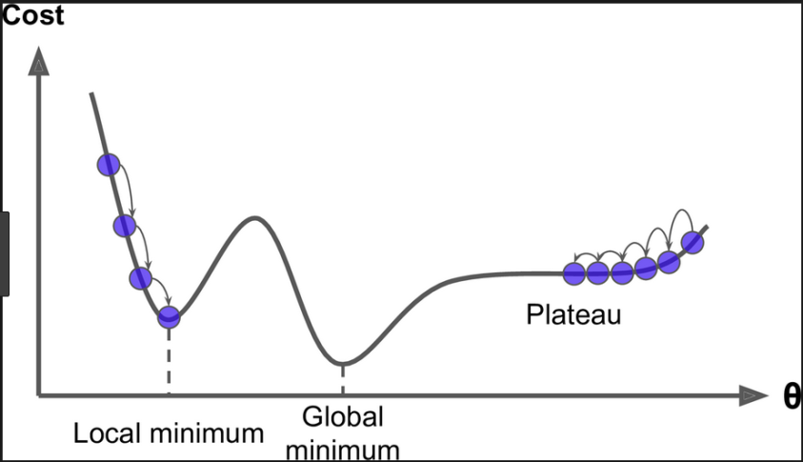
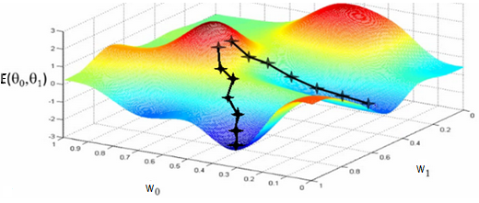
The backpropagation algorithm
The „hill climber” or „gradient descent” algorithm’s version for neural networks
We will decide based upon the gradient, which way to step in the error surface „gradient method” – principle of steepest descent: we will step in the opposite direction compared to the gradient vector
Start from a random initialization
Step size is set heuristically („learn rate”) – we will see later
Iterative (continue stepping until we get stuck)
Only guarantees converging to local optimum

Slide 11
The backpropagation algorithm for a single neuron (reminder)
Single (sigmoid activation) neuron MSE loss function:
By grouping these together, the dependence of E(w) from a concrete w_{j} can be observed
Differentiation: derivations using the chain rule
Weight updates in every step: $w_{i}=w_{i}−η\frac{∂E}{∂w_{i}}$
Where η is a small positive constant („learning rate”)
- Objective function
- activation function
- Linear activation

Slide 12
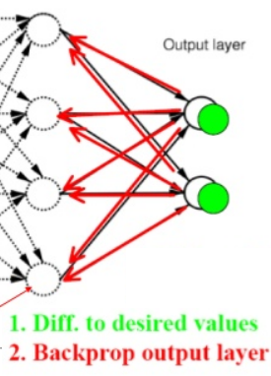
The backpropagation algorithm in general
General case: multiple output neurons, multilayered network
The chain rule is applied again, with multiple steps (the input of the hidden neurons is not x, but the output of the previous layer’s neurons)
(for simplicity D is omitted from the equation’s derivation (deduction))
The derivative (shorty: „error”) is calculated firstly for the output layer
Then the error is propagated backwards to the to earlier layers - layer by layer (backpropagation!)
Error of output unit k: ${\text{δ}}_{k}=o_{k}(1−o_{k})(t_{k}−o_{k})$
Error of hidden unit h (backwards by layers): ${\text{δ}}_{h}=o_{h}(1−o_{h})\sum_{k∈Uses(h)}{w_{kh}{\text{δ}}_{k}}$
Interpretation: a neuron’s error is proportional to the weighted errors of the neurons receiving its output
Where the weights equal to the given connection’s weight

Slide 13
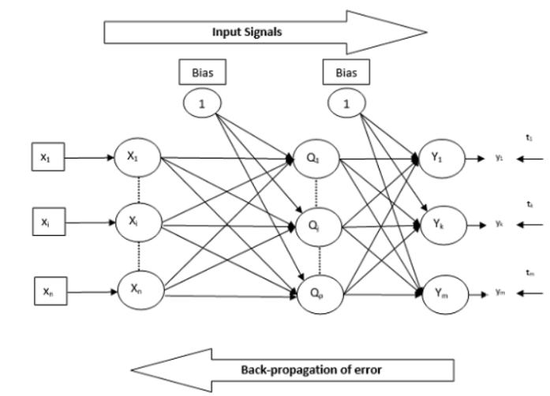
The backpropagation algorithm - Summary
All in all, the main steps of training with backpropagation:
Going from the inputs to the outputs, the output value of each neuron is computed over D training entities
The outputs are needed for the cost function!
From the output towards the input, the errors of each neuron is calculated
Weights are updated: $w_{ji}=w_{ji}+ηδ_{j}x_{ji}$
Note: backpropagation works with sparse networks too, or with skip connections between layers. The only hard requirement about the network is that there should be no recurrence (circle)
If there is not, then it can be updated in topological order (sequence)
If there is, then we get a recurrent network – training these is much more complicated
Useful video: What is backpropagation really doing? | Chapter 3, Deep learning

Slide 14
Stochastic backpropagation
Our cost functions are averaging the error over all train examples:
To evaluate this, the results of all entities are needed. This excludes e.g., online learning
On-line backpropagation: summarization over D is skipped from the error function. Instead for each incoming entity (one by one), we evaluate, then calculate the error and the weight updates
Semi-batch backpropagation: not one, and not all training examples are used for updating, instead we are taking a couple of data rows („batch”)
Factually, a slightly different cost function is optimized at every update! (calculated from the current batch)
Performance does not decreases, it is even better: a little randomness is introduced to the system – lowers the chance of getting stuck in a local minimum
Hence the name: „stochastic” gradient descent (SGD)

Slide 15
Semi-batch backpropagation
In practice, this (batch) approach is used exclusively
Advantages of batch based learning:
Lower chance of reaching a local optimum
Faster convergence
Faster execution (no need to process all training data at once)
Simpler implementation (one batch of data fits in memory)
Training in a (semi) online way is possible
Typical batch-size: 10-100-1000 examples
Similarly to when we are training with all examples, we iterate over the data set several times
One „training cycle” over the data is called: a “training epoch”

Slide 16
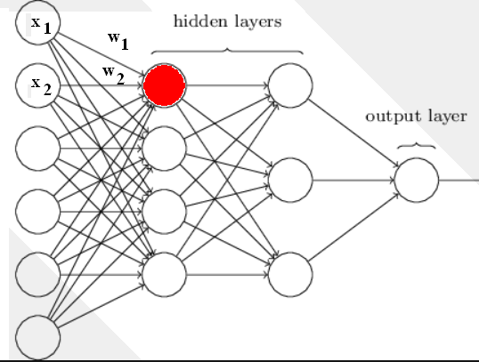
Backpropagation on the GPU
Why is it efficient to train neural networks on GPU-s?
Calculating the activation of one neuron: $a=\sum_{i=0}^{n}{w_{i}x_{i}}$ = vector-vector multiplication
But the neurons’ activations in a given layer can be computed in parallel! = matrix-vector multiplication
But this can be done for a batch of input vectors too in parallel! = matrix-matrix multiplication
GPU-s can compute the cell values of the matrix multiplication in parallel – 30-40 times quicker, than a single CPU

Slide 17
Training tricks and tips
The backpropagation algorithm provides the mathematical basis to train neural networks
However it only guarantees finding a local optimum, so in order to achieve good training results, some practical tricks are also beneficial
These are more or less heuristics, not precisely formulated theories
The most important practical tips are introduced in the next slides:
Normalization, randomization of data points
Weight initialization
Fine-tuning the learning rate

Slide 18
Randomization of training data
Shuffling (sorting in random order) of data vectors can help in semi-batch training
Necessary, if for example the examples are not shuffled well based on their class labels (e.g., first part contains only examples from the 1. class, then the 2. class, etc.)
Shuffling can also help, when the labels are mixed, but the sequence of the examples are not random based on some other factor (e.g., speech recognition: records are sorted by the order of speakers)
This matters, because we are optimalizing the cost function of the current batch, so the new data examples receive more attention than the older ones – the system memorizes the special properties of the fresh examples and forgets the patterns of earlier ones
The data must be iterated over several times → theoretically it is beneficial to randomize the order of training examples at the start of every training epoch
Unfortunately randomization is not simple: if it is done in memory, then data fetching is slowed; if in file, it is complicated even more so.

Slide 19
Data normalization (standardization)
It is good practice to transform the values of the features to uniform scale
min=-1, max=1: not the best, one outlying data point („outlier”) can wreck it
Usual solution: mean of features should be 0, standard deviation 1
Why does uniform scaling help?
The weights are initialized by a uniform distribution. If the features are from different scales, some features would suppress others when calculating the activations:
Fever | Joint pain | Coughing | Flu?
38.2 | Yes | No | Yes
36.7 | Yes | Dry | No
41.2 | No | Mucopurulent (wet) | Yes
38.5 | Yes | Dry | Yes
37.2 | No | No | No

Slide 20
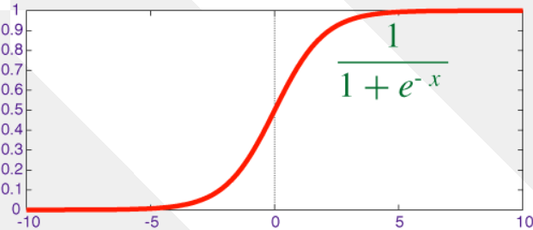
Data normalization (2)
Why are we normalizing to be close to 0?
Remember the sigmoid activation function:
If is too big or too small, then the values are calculated by the sigmoid’s „flat” part → the derivative here is essentially 0, the system will not be able to learn („vanishing gradient” problem)
We will talk about this in detail when we are experimenting with new activation functions or when we are employing methods of regularization

Slide 21
Weight initialization
Weights are initialized using small random values
For example random numbers from [-0.1, 0.1]
Initialization methods are especially important when dealing with deep ( = containing many hidden layers) neural networks
A good initialization helps error backpropagation to the lowest layers
There are a couple of initialization strategies, the strategy could depend upon the activation function in use
E.g., the weights’ initial values should come from a Gaussian distribution with an expected value of 0 and a standard deviation of 1/number_of_inputs
The reasoning is the same (when normalizing too): we would like to keep the multiplication in the same range

Slide 22
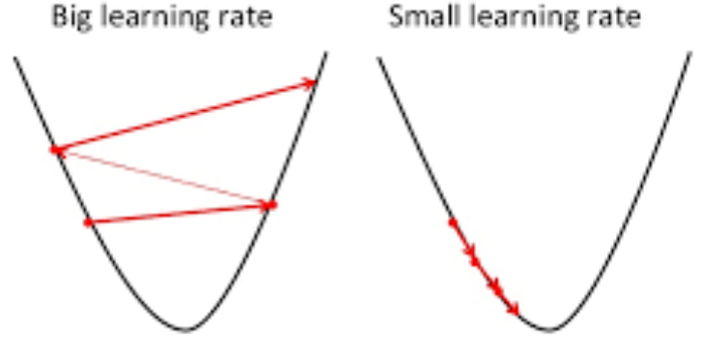
Setting the learning rate
Usually the learning rate is chosen by experimenting\experience
Although there are automatical optimalization methods
Learn rate too big: no learning, jumping around in the error surface
Learn rate too small: slow training, easier to be stuck in a local optimum
Traditional general heuristic
Start with a learning rate as large as possible (there is training)
After a while (if the error is not decreasing) start lowering it (e.g., by halving the LR)

Slide 23
Setting the learning rate (2)
To avoid overfitting, it is generally recommended to not only monitor the loss change of the training set, but to observe its course on a validation set too
Updating learning rate with a validation set:
Separate a part of the data before training → validation set
After a number of training steps (e.g., 1 epoch), evaluate the error using the validation set
If the result of the evaluation is a lower error value than in the previous one: next iteration If the error increased, or its decrease is smaller than a threshold, → divide learning rate by two
Full stop: if the learning rate reaches a certain threshold

Slide 24
Thank you for your attention!
A tananyag az EFOP-3.5.1-16-2017-00004
pályázat támogatásával készült.

