Slide 1
The perceptron neural model and its training

Slide 2
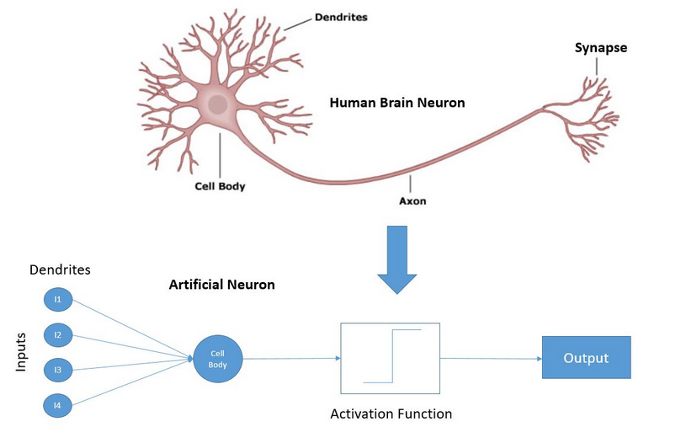
The „perceptron” neural model
The most known neural model is the “perceptron”
Invented by Rosenblatt in1957
He reasoned that a compelling similarity exists between the perceptron and real biological neurons
Many inputs – “dendrites”
Single output – “axon”
If the sum of excitations (weighted) reaches a threshold, the neuron fires, elsewise it remains calm – the neuron’s output is binary (in the original model), this is facilitated by the activation function

Slide 3
The perceptron’s mathematical modell
The inputs correspond to the x₁…x_{n} features
The strength of the connections are modelled by the w₁,..,w_{n} weights
In addition, there is an w₀ “bias” parameter
The sum of excitatory signals reaching the neuron is called activation:
Simplified with fix x₀=1 input:
From activation a, the o(a) output is produced by the activation function
In the original model this was a simple step function:
The model’s learnable parameters are the w₀,..,w_{n} weights

Slide 4
Training the perceptron
Rosenblatt not only invented the perceptron model, he also described a simple training method
This is known as the „perceptron training rule”
We want to separate to classes
We expect -1 as output for one class, 1 for the other
The perceptron training rule
Iterative algorithm (it iterates over the training examples, (multiple times if needed))
If an entity is correctly classified, the system does not modify anything
If the classification is false, the weights are adjusted
It can be proved, that if the two categories are linearly separable, then this method will find a good solution in a finite amount of steps
However, it does not guarantee anything in the case of non-linear problems
We will prefer other methods because of this

Slide 5
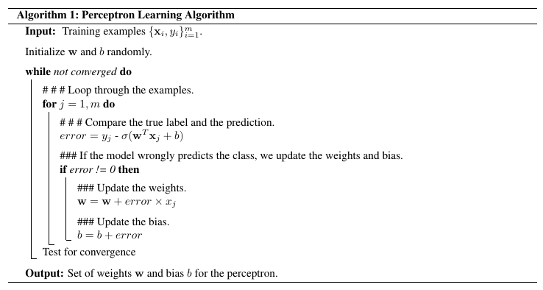
The perceptron training rule
The training algorithm proposed by Rosenblatt:
Prove, that after modifying the weights, the activation changes in the right direction (for the given example) :
The sign of the activation’s change is decided by (t-o)
If t=o, no change
If t<o, the activation decreases
If t>o, the activation increases

Slide 6
W
X
Ŷ
Y
0.5
0.
0.
1
·
W + ∇W
0.3

Slide 7
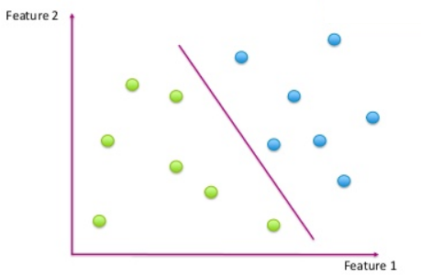
Interpreting the neuron’s output
The is an equation of a line (higher dimension: hyperplane)
The neuron gives an activation value of 0 at the hyperplane defined by the weights
The activation is positive on one side of the hyperplane, negative on the other
This way the activation function outputs a value of 1 on one side and -1 on the other
So the perceptron is capable to divide the space into to parts along the hyperplane
All in all, it can only separate the entities of the two classes, if the are on different sides of the hyperplane
And the perceptron learning rule only works (converges) in this case

Slide 8
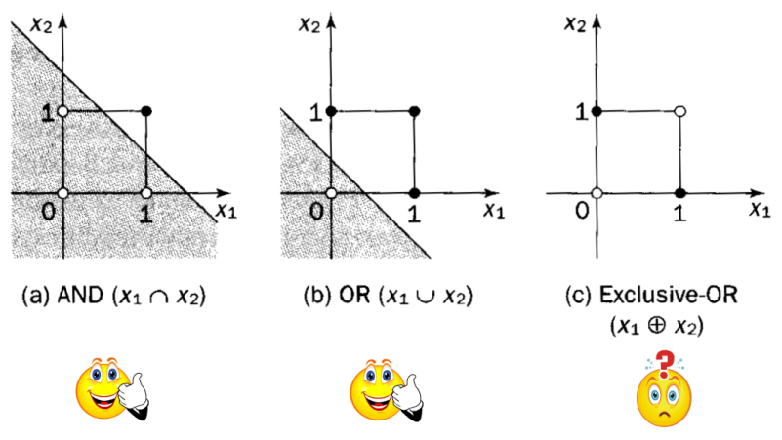
Representational power of one neuron
Separation by a line is a weak representational capability (ability to learn) in practice Unfortunately only a few real-world tasks can be solved with such simplicity…
For example the AND and OR operations can be learned, the XOR cannot:
This was shown by Minsky and Papert in 1969
Because of this, the research of the neural-model was delayed until 1980 (this was the first „AI winter”)

Slide 9
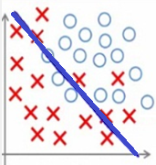
Training by cost function optimalization
Perfect classification can only be guaranteed with one neuron if the two categories are linearly separable
And the perceptron learning rule only works in this scenario too
We would be interested in classifications with a small error rate…
When only a few points are on the wrong side…
How can we find the linear classification with the smallest error?
For this „small error” needs to be formalized
For approaches such as this, we need to formalize (i.d., make it numerical) the error of the classifier by defining a function
This function is called: cost function, loss function, objective function …
The variables of the function are of course the weights of the neuron

Slide 10
The Mean Squared Error (MSE) cost function
The simplest cost function is the MSE loss functions
Let t denote the neuron’s expected output value („target”)
Let o denote the neuron’s observed output value („output”)
Then the squared difference of t and o is (t-o)²
Naturally, the cost value described above for all training examples is what we are interested in, so we average the cost/loss values over all entities in our training set D
This will be the Mean Squared Error, MSE:
Let’s not forget, that the variables of the cost function are the weights of the neuron, since the value of output o depends on the w weight vector and the x input vector (but the latter is fix, so we can only change the weights…)

Slide 11
Training by cost function optimalization
The optimal weight values are found by optimizing the cost function (in our case, minimization)
This way, a machine learning problem is cast as an optimalization problem with many variables
Note, that while this method does work for neural networks, it is a more general solution
In simple cases, the global optimum can be given by a solvable equation
Iterative algorithms are used in more complex cases
In the hardest cases, these iterative algorithms can not guarantee a global optimum, just a local one
This method of cost function optimization can solve cases, where the perceptron learning rule would fail
And it is expandable from a single neuron to neural networks too
So we are going to use this instead of the perceptron learning rule

Slide 12
The “gradient descent” algorithm
The simplest general optimalization algorithm for multivariable functions
Assuming that we want to minimize the E(w) multivariable function
The derivate of the function(in multivariable case: its gradient vector):
We know, that this value is zero at the minimum point
So we should calculate the gradient and make it equal to zero
Unfortunately in many practical scenarios the solution is too hard to solve formally
The gradient descent algorithm is an easier solution:
Iteratively decreases the value of the cost function
Always steps in the direction of the steepest decrease
Which direction is determined by the vector of the gradient

Slide 13
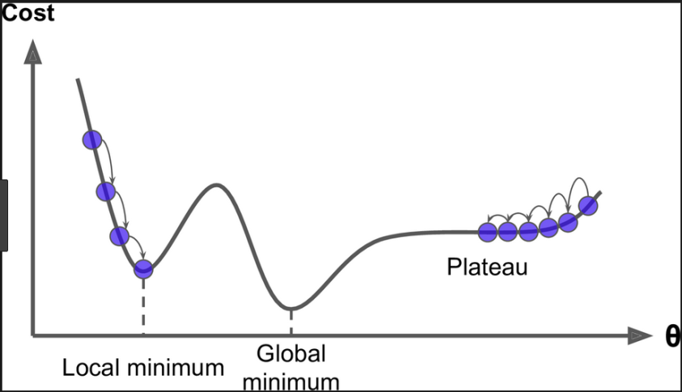
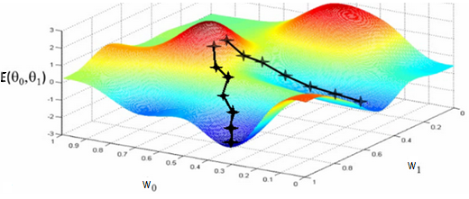
The “gradient descent” algorithm(2)
A variation of the „Hill Climbing” algorithm for continuous functions
We decide based on the derivative, which way to go on the loss surface („gradient based method”) – decrease through gradients: we will step in the opposite direction (compared to the gradient vector’s)
Start from a random initialization
Step size is set heuristically („learn rate”) –more about this later
Iterative (we continue taking steps until we get stuck)
Only guarantees convergence to local optima

Slide 14
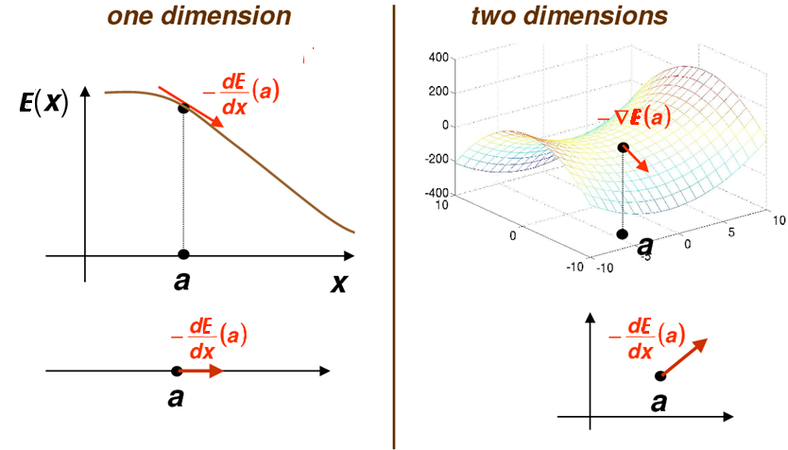
Visualization of gradient descent

Slide 15
Gradient descent – iterative algorithm

Slide 16
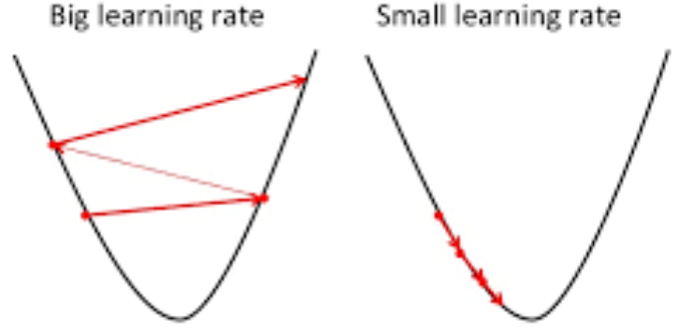
Weak points of gradient descent
Gradient descent can get stuck in local optima
If the learning rate is too small, the algorithm converges very slowly
If the learning rate is too big, it will not find the optimum
Later we will see heuristics on how to choose a good learning rate

Slide 17
Variants of gradient descent
The actual model’s (model = value of parameters) error is generally defined by the sum of the cost function computer over all training examples
This is called the off-line or „batch” version of the algorithm
Although the algorithm’s on-line or semi-batch version can be used too – when the data is divided into batches
This time the error is calculated using only one example (on-line), or on a couple (batch) of examples and then we update the model parameters
This variation is the stochastic gradient descent (SGD):
Because in every iteration the error is calculated using a different subset of examples, in every step a slightly different version of the original cost function is being optimized (because that is defined over all train entities)
This introduces a small amount of randomness into the method
But this does not hurt in practice, quite the opposite, it helps to avoid local optima and results in a faster convergence

Slide 18
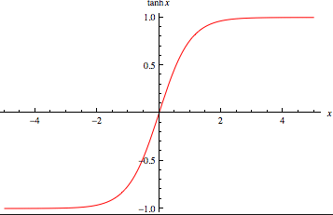
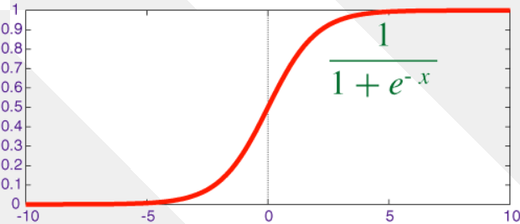
The sigmoid activation function
To train with gradient descent, one more thing needs to be solved:
It only works with differentiable functions, but our activation function is a step function, it is not differentiable:
So tanh is used instead, which is very similar in shape:
The sigmoid function is more widespread, (right hand side), which has the same shape, but its range is (-1,1) instead of (0,1)
Both of them are differentiable so there are no more obstacles, gradient based training can be applied

Slide 19
The sigmoid activation function (2)
The MSE cost function works for arbitrary real t target and o output values, and is not restricted to values of -1, 1
By changing the step activation function, the neuron’s output can be extended from -1,1 to any value from the interval of (0,1)
So – theoretically – we can use any number from (0,1) as the target values
When dealing with continuous target values, the task is called regression, and not classification
Since the sigmoid activation function restricts output values to the range of (0,1), for regression tasks a linear activation function (f(x)=x) is often used instead

Slide 20
Neuron training with the gradient descent algorithm
Single (sigmoid activation) neuron MSE loss function:
By grouping these together, the dependence of E(w) from a concrete w_{j} can be observed
Differentiation: derivations using the chain rule
Weight updates in every step:
Where η is a small positive constant („learning rate”)
- Objective function
- activation function
- Linear activation

Slide 21
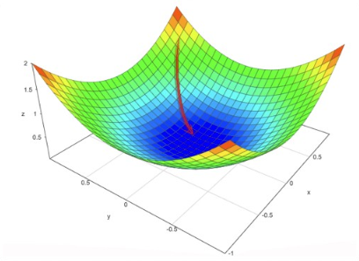
Neuron training with the gradient descent algorithm (2)
With a linear activation function the MSE error surface is quadratic containing a single global optimum
The gradient descent algorithm guarantees finding that global optimum (if the learning rate is being decreased with care – see later)
When using sigmoid activation function the convexity of the error surface is not granted/assumed, so theory only guarantees finding a local optimum, but empirical results show that the algorithm still performs well

Slide 22
Thank you for your attention!
A tananyag az EFOP-3.5.1-16-2017-00004
pályázat támogatásával készült.

