Slide 1
Artificial neural networks and their applications
Created by: Dr. László Tóth Translation by: Gergely Pap

Slide 2
Machine Learning Fundamentals
2022-23-2

Slide 3
The goal of machine learning
Goal: Creation of programs that can improve upon their own performance with experience gained during their utilization
Learning algorithms: algorithms that are able to discover patterns and relationships based on a training set of examples
1. note: The point is not to memorize the training entities, but to gain the ability to generalize to previously unseen examples
2. note: the presumed relationship (or rule) is called a „hypothesis”, because we can never be sure that it will work on unknown/new examples
3. note: the hypothesis can be improved by introducing further examples, new and unseen training entities

Slide 4
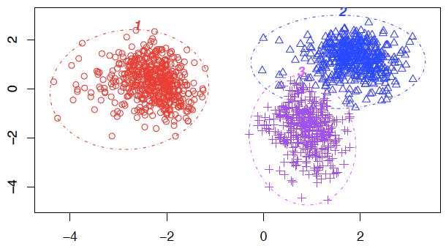
Types of machine learning tasks
Supervised learning: for every learning example, the expected output is known
Typical task: classification
Example: character recognition
Input: images depicting characters
Output: (this is the task of the machine) which letter is in the image?
In the case of supervised learning, for every element of the training set, the expected output is also given (which letter is shown on the image)
Unsupervised learning: the machine needs to figure out the number of classes by itself automatically, e.g., based on some measure of similarity
Typical task: clustering

Slide 5
Task types (2)
Neural networks were originally developed to solve classification problems, thus to provided an output of fixed size to the corresponding input (of fixed size also)
There are other, important, special task types, that do not necessarily fit into this classical problem description, e.g.,
Modelling time series data (temporal processes)
The current output depends (can depend) on the previous input, e.g., video recognition, speech recognition, prediction of stock market
Sequence →sequence modeling: machine translation
The length of the sequence is not fixed
The size of the input-output can differ
There are no unambiguous (obvious) word-word pairs, the order can be mixed

Slide 6
Task types (3)
Reinforcement Learning
For example: creating artificial „organisms”
It interacts with its surroundings, gathers experiences and reacts to those
Unlike classification, there are no labels for each and every event, only a long term goal (e.g., survive as long as possible)
Real world example: learn to play chess (or go)
Objective: win the match, the individual moves cannot be classified simply as a good or bad move
Summary: artificial neural network models were fundamentally implemented to solve classification problems, but recently many attempts were made to use them for different, more complex tasks (combined with other algorithms or just by itself)

Slide 7
Classification
The most common machine learning problem
Goal: to sort objects (entities) into one of the predefined c₁,…,c_{M} classes
Input: a vector (of fixed size) containing data from some measurements
Feature vector, attributes
Set of train examples: a set containing pairs (a feature vector and the corresponding class label)
Example: does the patient suffer from the common flu (influenza)?
F e a t u r e v e c t o r Class label (Y/N)
Fever | Joint pain | Coughing | Flu?
38.2 | Yes | No | Yes
36.7 | Yes | Dry | No
41.2 | No | Mucopurulent (wet) | Yes
38.5 | Yes | Dry | Yes
37.2 | No | No | No
Training examples

Slide 8
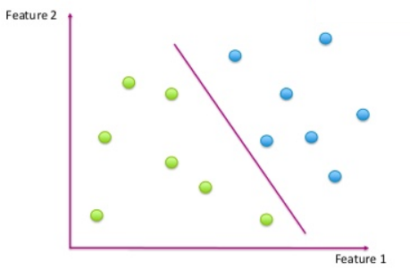
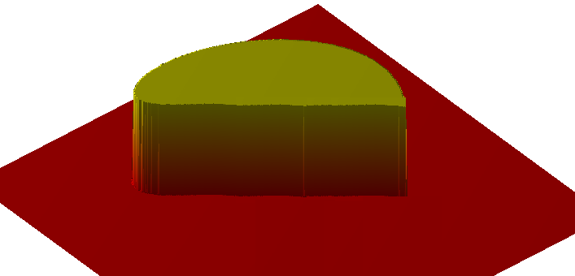
The feature space
If our feature vector contains N components, then our train examples can be drawn as points of an N-dimensional space
Example:
Two features –> 2 axis (x₁, x₂)
Class label (c): denoted by colours
So the task of the learning algorithm is to give a prediction about the function of (x1,x2)→c based on the training examples
In case of M classes, this is equivalent to learning M (x1,x2)→{0,1} characteristic functions
The characteristic function can be hard to represent if the feature space is continuous and has gaps
There are two ways to model the function with gaps described above continuously

Slide 9
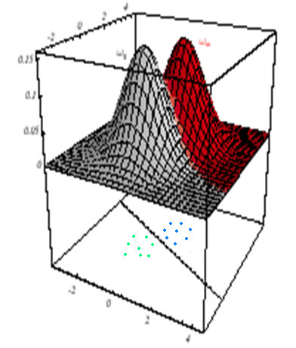
Representing the decision surface
Direct (geometrical) view: the bounding surfaces are represented
By some simple method, e.g., with lines
Indirect (decision theory) approach:
For each class we define a function, that describes the amount by which each point (of this space) belongs to that class. This is similar to the characteristic function, but it can also be continuous.
From the discriminant functions, class labels can be derived by classifying a given point to the class of the function which has the highest value
The boundaries of the classes are indirectly defined by the intersections of the discriminant functions
Both approaches can be used to interpret the workings of a neural network!

Slide 10
Basics of statistical pattern recognition
Classification from a statistical point of view
This is one of the most popular approaches of machine learning in practice
Solid mathematical background (probability theory/statistics)
It gives solutions that can be implemented/used in real life
The most important aspect of this is Bayes’ Rule, which provides a mathematical formalism behind viewpoint of decision theory
Objects to be classified → x feature vector
Task: classify the objects into one of the {c₁,..,c_{M}} classes
Goal: minimize the number of false classifications on the long run
Bayes decision rule: given a feature vector x, class i needs to be chosen so that P(c_{i}|x) is maximal
So the method of decision theory gives an optimal solution, if the P(c_{i}|x)-s are used as discriminant functions
From here pattern recognition = approximating P(c_{i}|x) as closely as possible based on the train examples

Slide 11
Statistical pattern recognition and neural networks
The behaviour of a neural network can be explained by the simpler „geometrical” approach
Meaning that the network is trying to find the boundaries between the classes
This explanation is the simpler, easier to understand
The neural network can also be explained as a model of statistical pattern recognition
It can be proven, that given certain assumptions the neural network’s outputs can be described as the approximations of probability P(c_{i}|x) for the classes
These in turn satisfy the requirements about the discriminant functions of the decision theory’s approach
This explanation is more complex, but much more useful in terms of math (makes it possible to analyse and interpret the models mathematically)
In the future we will explore both of these approaches

Slide 12
Evaluation
Result of training: the machine learning algorithm produces a model based on the training examples, a hypothesis for the (x1,x2)→c func.
It can predict a class label for a given (x1, x2) point of space
How can we know, how good or bad is this model?
We can measure, how many examples of the training set are classified correctly
Our main objective however is not to learn the labels of the train set, but to generalize to examples not encountered during training!
Measuring accuracy on training examples is tricky: a flexible model can learn the training entities well, so its error will be small after training, but it is possible (even likely), that it will generalize poorly to even slightly different new examples

Slide 13
Evaluation (2)
How can we give a prediction of the model’s ability to generalize?
The train examples can not be used because of the aforementioned reasons
However labelled data is needed to compare the predicted and the true labels
Solution: a set of the training examples is separated, not used while training
This will be the so called test set
Steps of training+evaluation:
Split data into training and test set
Train the network using the train set
Evaluate the network with the test set → predicted labels
Compare the predicted and the true labels on the test set
Classification error percentage = $\frac{\text{number} \text{of} \text{wrongly} \text{classified} \text{entities}}{\text{number} \text{of} \text{all} \text{entities}}$

Slide 14
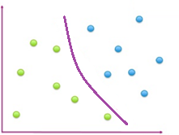
Parameters and metaparameters of a machine learning model
Every machine learning algorithm has optional parameters
Let’s look at a previous example, where we are trying to separate two classes with a line
The model’s parameters in this case are the coefficients of the line
These are being optimized during training, this way it is moved in the optimal direction and position
What are those meta-parameters (or hyperparameters)?
Generalize the model from above, so that it uses a polynomial instead of a line
The degree of the polynomial will be the algorithm’s metaparameter
Parameters are used to fit the model to the data, metaparameters are for controlling the flexibility, the representational strength of the model
Parameters are set by the training algorithm, metaparameters are chosen by us manually, using some kind of heuristic
In case of neural networks, meta-parameters are: number of neurons, number of layers, etc.

Slide 15
Parameters and metaparameters of a machine learning model (2)
Slightly different models are produced using slightly different metaparameters
How can we find the optimal metaparameters?
A small validation (or development) set is split from the training set
So we split our data to train-dev-test sets
We fit the model on the training set several times using different metaparameter values
We then evaluate the models using the development set
Finally we use the test set to evaluate the best model from the dev. set
Notes:
https://towardsdatascience.com/train-validation-and-test-sets-72cb40cba9e7

Slide 16
Rule of metaparameters
A neural networks parameters: the weights of the network
The main metaparameters are: number of neurons, number of layers,
The size of the network is set by these hyperparams.
Bigger networks are able to form more complex decision surfaces
By using different metaparameter values, we get different models
How can we find the optimal metaparameters?
Should we use a really flexible model?
Unfortunately it is not always a good idea, because the training examples can be misleading (we have only a sample from an infinite distribution), or they can be erroneous (i.d., noisy)

Slide 17
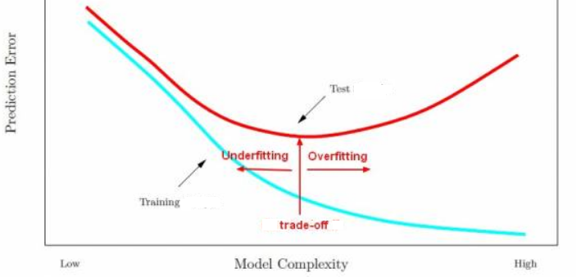
Generalization and overfitting
Infinite feature space, finite number of train entities → we can never be sure, that the learnt model generalizes well to new examples
By increasing a model’s size, its flexibility also increases, it will be more accurate on the training examples
However it’s performance measured on test examples will decrease after a while
This is called overfitting: after learning to generalize to some degree, the model starts to memorize the noise or the unique features of the train set

Slide 18
Finding the optimal model size
The optimal size of the model can be very different on different tasks
Apart from the type of the current task, it depends upon the number of entities, number of features…
Complex theoretical background: „No free lunch” theorem
Machine learning expertise (experience) is required to set it correctly
Although there are novel ways to automatize this
Some „rules of thumb”:
„There is no data like more data” – as the number of train examples increases, the size of the model can be also increased without the danger of overfitting
One should try to use a small number of useful features („curse of dimensionality”)
A lot of features (compared to data set size) can increase the chance of overfitting
When dealing with a small sample size and/or large feature space, using regularization techniques can be beneficial (we will discuss this later in detail)
Note: „deep learning” only really makes sense with a huge amount of data

Slide 19
Choosing metaparameters in practice
Slightly different models are produced using slightly different metaparameters
How can we find the optimal metaparameters?
The model’s performance should be measured with different metaparameters using a test set
The test set used for final evaluation should be different from the one used to set the parameters and the hyperparameters
A small validation (or development) set is split from the training set
So we split our data to train-dev-test sets
We fit the model on the training set several times using different metaparameter values
We then evaluate the models using the development set
Finally we use the test set to evaluate the best model from the dev. set

Slide 20
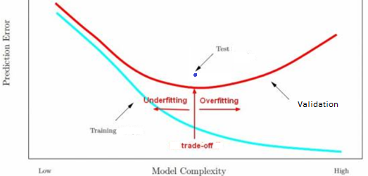
Choosing metaparameters in practice (2)
Plotting it on a figure:
We train several times on the training set (with different metaparameters) – we can plot the blue curve
We evaluate the models on the validation set – red curve
We only evaluate on the test set with the best model from the val. Set – blue dot

Slide 21
Thank you for your attention!
A tananyag az EFOP-3.5.1-16-2017-00004
pályázat támogatásával készült.

