Slide 1
Artificial neural networks and their applications Introduction
2022/23/2

Slide 2
Contact
Pap Gergely (papg@inf.u-szeged.hu)
http://www.inf.u-szeged.hu/~papg/ann_english/
Course materials taken from and by the courtesy of L. Tóth and T. Grósz; https://www.inf.u-szeged.hu/~tothl/ - http://www.inf.u-szeged.hu/~groszt/index.php?id=teaching

Slide 3
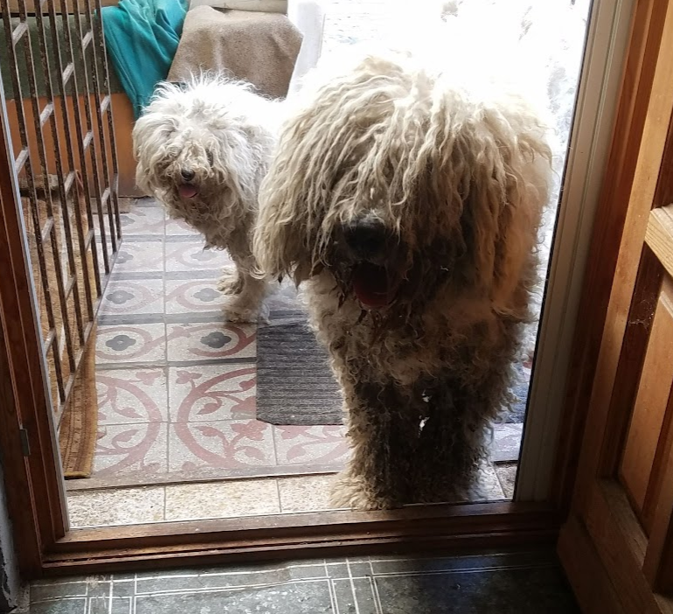
What is Deep Learning?
It is a discipline of artificial intelligence, a subfield of machine learning. Its goal is to learn relationships from data. One of the most popular tasks of DL is image classification. (is it a cat or a dog in the picture?)

Slide 4
Topics, syllabus (theory)
Basic machine learning definitions
Artificial Neuron, Neuronal Network, Deep Neural Network’s Structure, architecture
Learning Neural Networks
Activation functions
The problem of overfitting, methods of regularization
Regressions, autoencoder networks
Convolutional Neural Nets (CNN)
Recurrent Networks(RNN, GRU, LSTM)
Transfer Learning, augmentation
(RBM, DBN)

Slide 5
Precognition (prerequisites)
I will try to explain the theory in a way that makes the mathematical parts easy to understand. It could be useful to refresh one’s knowledge about:
some linear algebra (matrix, vector definitions)
very basic probability theory
The practical part of coding will be in python. In the beginning of the course, I will give a short introduction to python, some coding experience is needed (not necessarily in python)

Slide 6
Planned course materials (practice - coding)
Python basics
Google Colaboratory usage
TensorFlow introduction
Neuron, artificial neural network, deep networks
Learning networks, optimization
Activation functions
Overfitting, regularization
Regression, autoencoder models
CNN, augmentation, transfer learning
RNN, LSTM, natural language processing
(RBM, DBN) - if we have time at the end of the course

Slide 7
Requirements
Practical part:
1st test: march 22. - Coospace (test-like questions, short essay parts)
2nd test: may 03. - Coospace (longer essay questions, coding tasks)
- the dates of the midterms might change, in that case I will notify you on CS
Points: Tests are 10-10 points, the exam is 20 points. Minimum 10 points are required from midterms to be eligible for the exam. At the end of the semester, there is an opportunity to write a test, which can substitute one of the other two written during the semester (in case of absence or unfortunate performance) If the points from the two midterms are equal to or above 18, a mark of 5 will be offered.
Grades: < 19 : 1 20 – 24 : 2 25 – 29 : 3 30 – 35 : 4 36 – 40 : 5
Lecture exam: oral
Two random topics – both must be presented at an acceptable level: minimum 50%

Slide 8
Additional materials
Lecture:
Bishop: Neural Networks for Pattern Recognition
Ian Goodfellow and Yoshua Bengio and Aaron Courville: Deep Learning
https://www.deeplearningbook.org/
Deep Learning with TensorFlow - Second Edition - Giancarlo Zaccone , Md. Rezaul Karim
Coding practice (jupyter notebooks):
Tensorflow\keras tutorials, medium or towardsdatascience blog posts, kaggle

